Slide 2
Weekly Report: Management Team
Week number: 03
Date: 14/10/2025
Supervisor: Prof. Quell
Presented by: Federico De Mita & Bakhtyar Karim/ Josef Remberger

Slide 3
List of contents
Main Design Parameters
Rated Rotor Speed from Benchmarks
Tip Speed
Comparsion with Benchmarks
Tip Speed selection
Why starting with tip speed?
Tip speed design drives
Noise regulations
Final decision
Bakthyar Karim

Slide 4
1. Main Design Parameters
Main parameters:
1. Rated rotor speed (n)
2. Tip speed (U_tip)
3. Tip-speed ratio (λ)
4. Average site wind speed: 9 m/s (IEC IIIa)
Why We Define These Parameters
Ensure consistent aerodynamic and drivetrain inputs for all teams.
Base design decisions on certified 5 MW-class benchmark turbines.
Support early modeling of rotor, gearbox, and electrical drivetrain.
[8]
Bakhtyar Karim

Slide 5
2. Rated Rotor Speed
Industry Benchmarks
Turbine Model | Rotor Ø [m] | Rated Power [MW] | Rated Speed [rpm]
GE Cypress 5.3-158 | 158 | 5.3 | 10.5
Nordex N163/5.X | 163 | 5.7 | 9.5
Siemens SG 5.0-145 | 145 | 5.0 | 12.0
NREL 5 MW Reference | 126 | 5.0 | 12.1
[1] [2] [3] [5]
Bakhtyar Karim

Slide 6
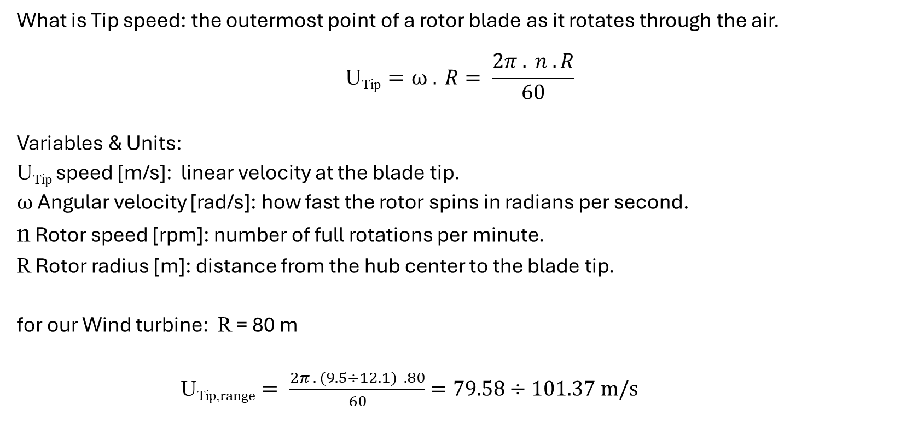
3. Tip Speed
What is Tip speed: the outermost point of a rotor blade as it rotates through the air.
$$\text{U}\text{Tip}=ω . R= \frac{2π . n .R}{60}$$
Variables & Units:
$\text{U}\text{Tip}$speed [m/s]: linear velocity at the blade tip.
$ω$ Angular velocity [rad/s]: how fast the rotor spins in radians per second.
n Rotor speed [rpm]: number of full rotations per minute.
R Rotor radius [m]: distance from the hub center to the blade tip.
for our Wind turbine: R = 80 m
$\text{U}\text{Tip}\text{,}range= \frac{2π . (9.5÷12.1) .80}{60}=79.58÷101.37 m/s$
Value will be finalized in the following slides
[5] [6] [7]
Bakhtyar Karim

Slide 7
3.i. Comparsion with Benchmarks
Turbine | Rotor Ø [m] | Rated Speed [rpm] | Tip Speed [m/s]
Siemens SG 5.0-145 | 145 | 12.0 | 91
Nordex N163/5.X | 163 | 9.5 | 81
GE Cypress 5.3-158 | 158 | 10.5 | 87
Goldwind GW155/4.5 | 155 | 10.0 | 81
Vestas V150-5.6 | 150 | 11.0 | 86
From Benchmarks Tip speed is ≈ 80–90 m/s for modern 5 MW turbines.
Why it is Important to determine Tip speed?
Determines aerodynamic efficiency, noise, and structural loading.
[1] [2] [3] [4] [5] [6]
Bakhtyar karim

Slide 8
Bibliography / Management team / PM
[1] Siemens Gamesa Renewable Energy, “SG 5.0-145 Onshore Wind Turbine,” Siemens Gamesa, 2024. [Online]. Available: https://www.siemensgamesa.com/en-int/products-and-services/onshore/wind-turbine-sg-5-0-145
[2] Nordex SE, “N163/5.X – Delta4000 Platform,” Nordex Group, 2024. [Online]. Available: https://www.nordex-online.com/en/product/n163-5-x/
[3] GE Vernova, “Cypress Platform – 5.3-158 MW Onshore Wind Turbine,” GE Renewable Energy, 2024. [Online]. Available: https://www.gevernova.com
[4] P. Bortolotti, J. J. Jonkman, L. Wang and A. D. Wright, “IEA Wind TCP Task 37: Systems Engineering in Wind Energy – Reference Wind Turbines,” NREL, 2019. doi: 10.2172/1529216.
[5] National Renewable Energy Laboratory (NREL), “NREL 5 MW Reference Turbine Documentation,” Golden, CO, 2020. [Online]. Available: https://docs.nrel.gov/docs/fy09osti/38060.pdf [6] Goldwind, “GW155/4.5 Wind Turbine Product Brochure,” Xinjiang Goldwind Science & Technology Co., Ltd., 2023. [Online]. Available: https://www.goldwind.com
[7] Vestas Wind Systems A/S, “V150-5.6 MW EnVentus Platform,” Vestas, 2024. [Online]. Available: https://www.vestas.com
[8] DNV, “Design Guideline for Certification of Wind Turbines (DNV-ST-0437),” DNV, Høvik, 2021.
Bakhtyar Karim

Slide 9
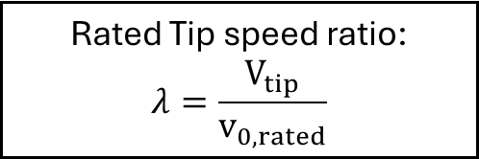
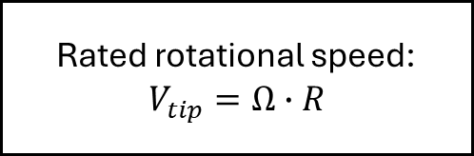
4.i Why starting with tip speed?
Design idea:
TIP SPEED
Rated Tip speed ratio:
$$λ=\frac{V_{tip}}{v_{0,rated}}$$
Rated rotational speed:
$$V_{tip}=Ω∙R$$
Mechanical torque calculation
Power coefficient calculation
Federico De Mita

Slide 10
4.ii Tip speed design drives
Main drives for tip speed calculation:
Main focus for Optimus Syria
1.Noise
2. Low Mechanical torque
LCOE
Can be also reduced by optimizing a high tip speed
3. More expensive rotor bearings
CAN BE REGULATED THORUGH TURBINE CONTROLLER
[1],[2]
Federico De Mita

Slide 11
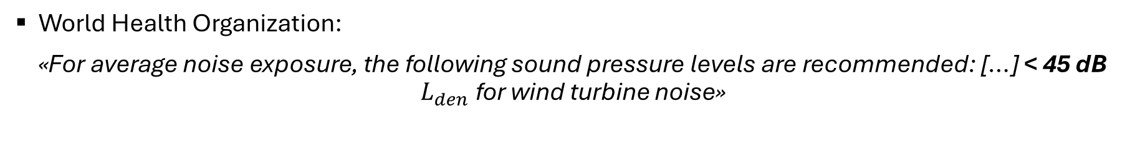
4.iii Noise regulations
Syria does not have any available source regarding wind turbines (or general ones either)
Thus, we have to refer to other standards from the nearby countries or from international standards:
World Health Organization (WHO)
Egyptian standards
Turkish standards
World Health Organization:
«For average noise exposure, the following sound pressure levels are recommended: […] < 45 dB $L_{den}$ for wind turbine noise»
[3]
Federico De Mita

Slide 12
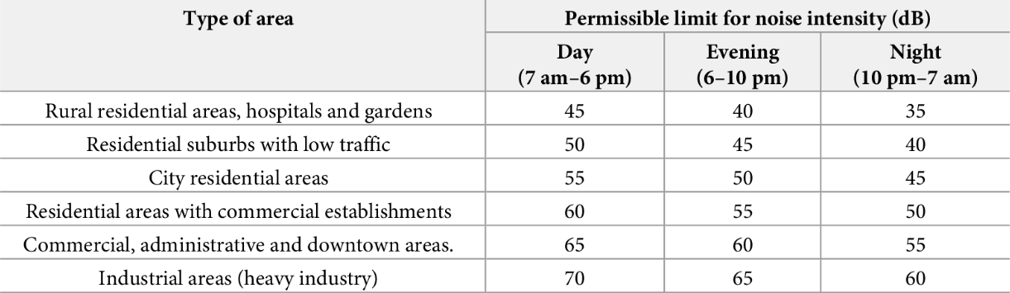
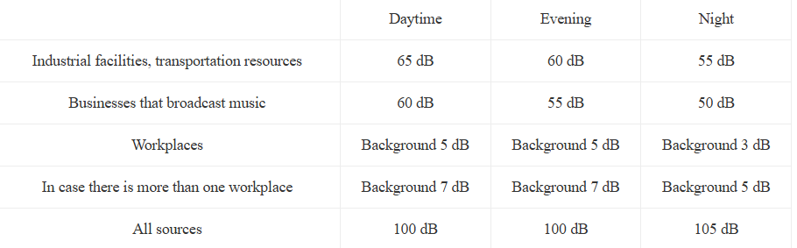
4.iii Noise regulations
Egyptian standards: Egyptian Environmental Law No. 4/1994 [4]
Turkish standards: Noise Control Regulation [5]
[4] [5]
Federico De Mita

Slide 13
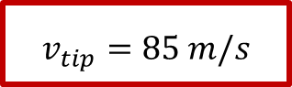
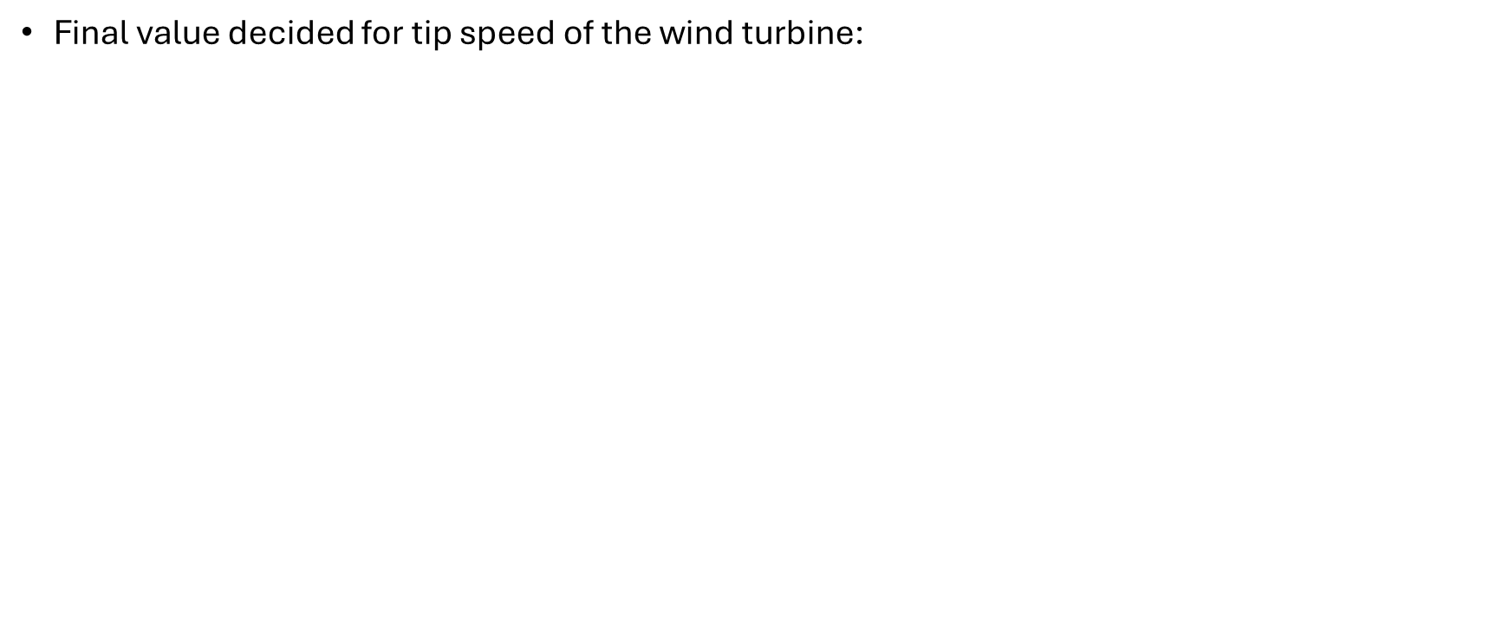
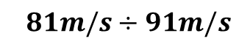
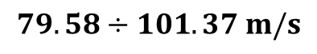
4.iv Final decision
Final value decided for tip speed of the wind turbine:
$$v_{tip}=85 m/s$$
Benchmark assessment
Based mainly on two criteria:
Noise regulation and specific case analysis
Benchmark assessment
From the rpm benchmark
From tip speed benchmark
Range from benchmark wind turbines:
$$79.58÷101.37 m/s$$
$$81m/s÷91m/s$$
85 m/s is a good value!
Federico De Mita

Slide 14
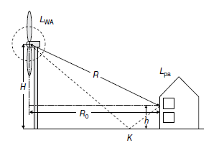
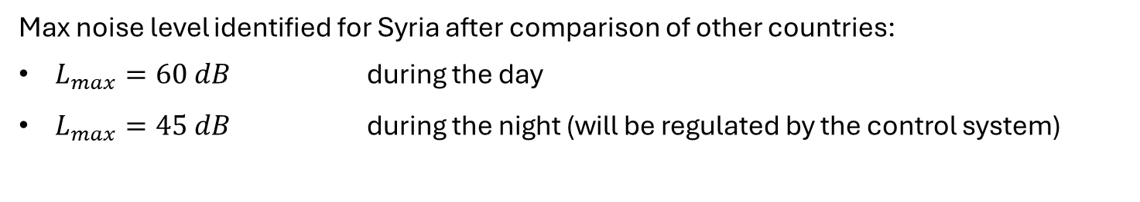
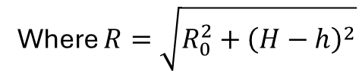
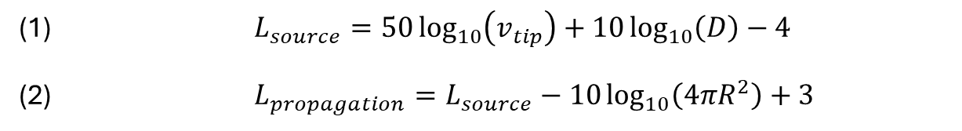
4.iv Final decision
Noise regulation and site specific analysis
Max noise level identified for Syria after comparison of other countries:
$L_{max}=60 dB$ during the day
$L_{max}=45 dB$ during the night (will be regulated by the control system)
Based on [6] we can test whether $v_{tip}=85 m/s$ would produce too much noise in the area:
(1) $L_{source}=50\log_{10}\left(v_{tip}\right)+10\log_{10}\left(D\right)−4$
(2) $L_{propagation}=L_{source}−10\log_{10}\left(4πR^{2}\right)+3$
Where $R=\sqrt{R_{0}^{2}+{\left(H−h\right)}^{2}}$
[6] Undertanding Wind Power Technology, A. Schaffarczyk, 2014
[6]
Federico De Mita

Slide 15
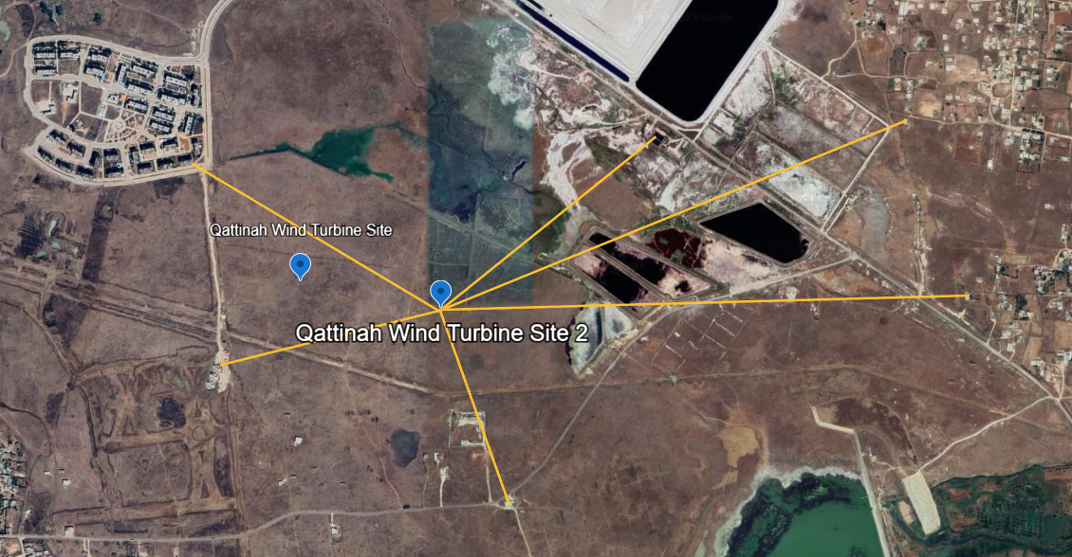



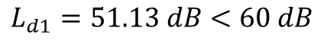
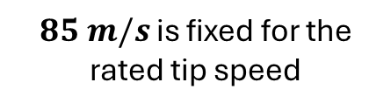

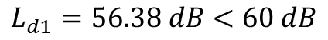
4.iv Final decision
Noise regulation and site specific analysis
$$L_{source,optimus}=114.5 dB$$
Distance to the nearest household: $d_{1}=577 m$
$$577 m$$
$$L_{d1}=51.13 dB<60 dB$$
Maximum distance of a household for a wind turbine: $d_{2}=300 m$
$$L_{d1}=56.38 dB<60 dB$$
$85 m/s$ is fixed for the rated tip speed
NEXT STEP:
TSR CALCULATION
$Ω_{r}=10.146 rpm$
[6]
Federico De Mita

Slide 16
Bibliography – Management team
[1] “Variable Speed Control for Wind Turbine Acoustics.” Accessed: Oct. 10, 2025. [Online]. Available: https://xray.greyb.com/wind-turbines/variable-speed-noise-reduction
[2] A. Ning and K. Dykes, “Understanding the benefits and limitations of increasing maximum rotor tip speed for utility-scale wind turbines,” J Phys Conf Ser, vol. 524, no. 1, 2014, doi: 10.1088/1742-6596/524/1/012087.
[3] “Chapter 11. Environmental noise,” 2022.
[4] Y. A. Farghaly, F. A. A. Hemeida, and S. Salah, “Noise utilization as an approach for reducing energy consumption in street lighting,” PLoS One, vol. 14, no. 7, p. e0219373, Jul. 2019, doi: 10.1371/JOURNAL.PONE.0219373.
[5] “Rüzgâr türbinlerinin gürültü etkisi | temizmekan.” Accessed: Oct. 10, 2025. [Online]. Available: https://www.temizmekan.com/ruzgar-turbinlerinin-gurultu-etkisi/
[6] A. Schaffarczyk, “Understanding Wind Power Technology.”, 2014
[7] S. Deshmukh, S. Bhattacharya, A. Jain, and A. R. Paul, “Wind turbine noise and its mitigation techniques: A review,” Energy Procedia, vol. 160, pp. 633–640, 2019, doi: 10.1016/j.egypro.2019.02.215.
Federico De Mita

Slide 17



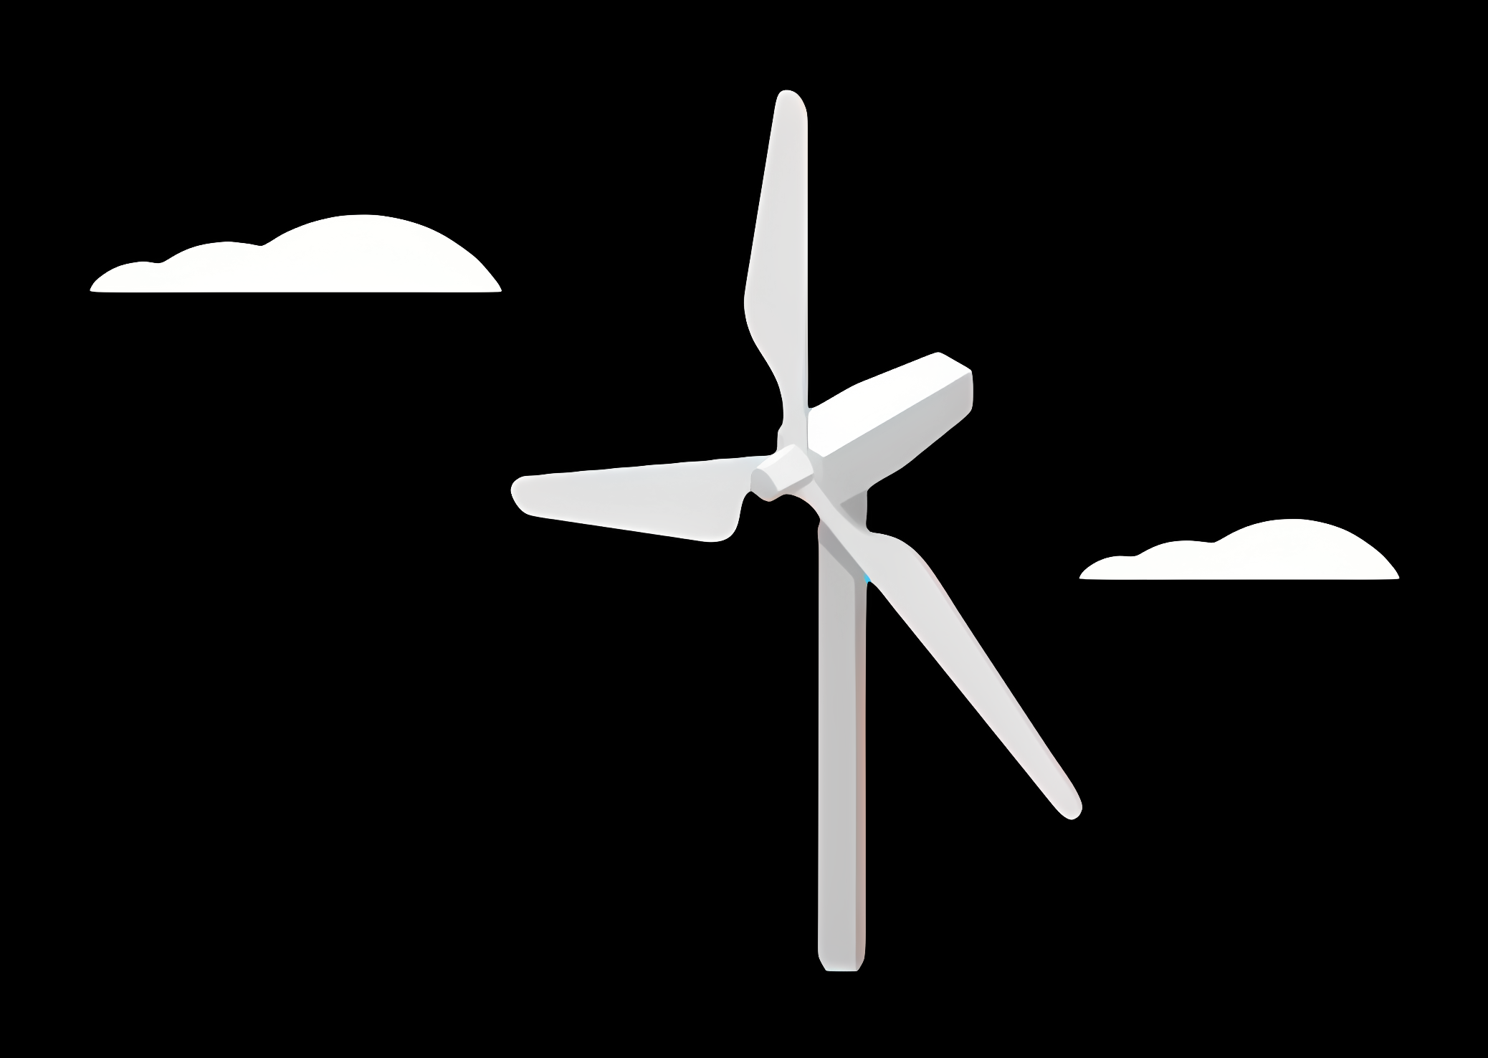
Weekly report: Team Project Development
Week number: 03 – Kick Off
Date: 14/10/2025
Supervisor: Dr. Marina Blohm
Group members: Ahmed Sallam, Luis Urhahn, Ceren Cetin, Sohail Mansuri
Presenter : Ahmed Sallam

Slide 18
List of content
1. Caratria of site selection
2. Wind speed calculations
3. Energy profile Syria
4. Site Comparison
5. Distance Analysis
6. Noise Regulation Context
7. Site final decision (Project Development Team)
Sila Ceren Cetin-770819

Slide 19
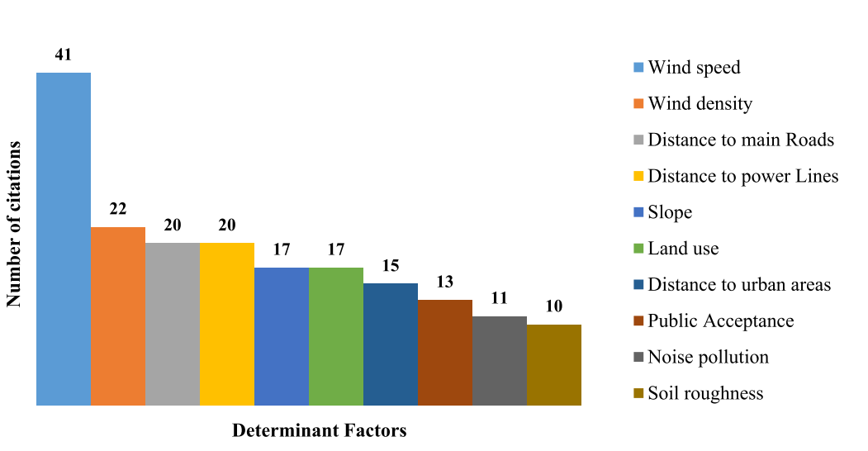
Criteria of site selection
Identify No-Go Factors
Optimize Factors
Balance Contradictory Criteria
Set Priorities
For site selection in Syria, all factors must be considered based on the available data. Critical constraints should be identified, favorable conditions optimized, and conflicting criteria balanced for informed decisions
Wind power plant site selection: A systematic review

Slide 20
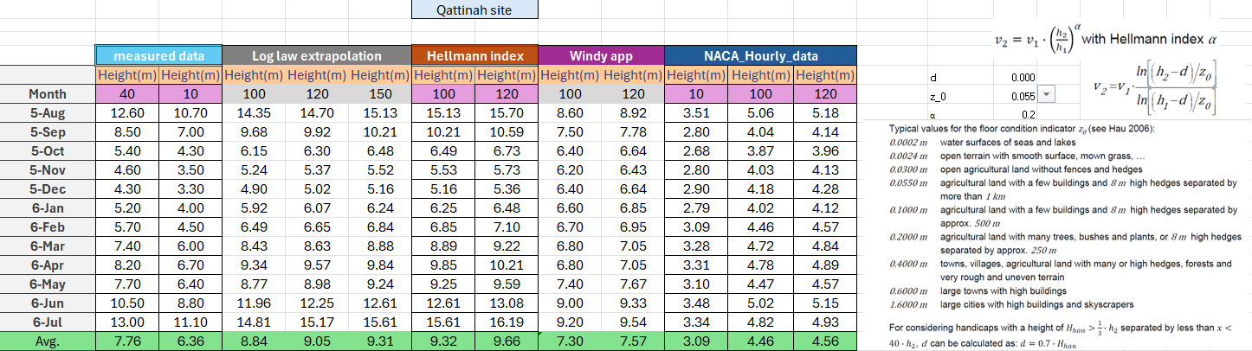
Wind Speed calculations:

Slide 21
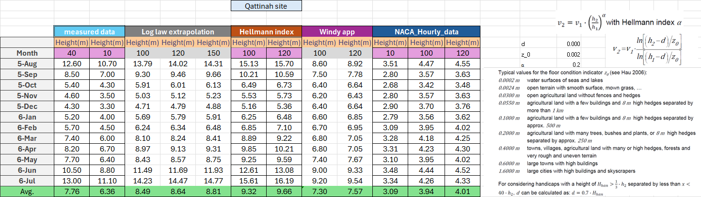
Wind Speed calculations:

Slide 22
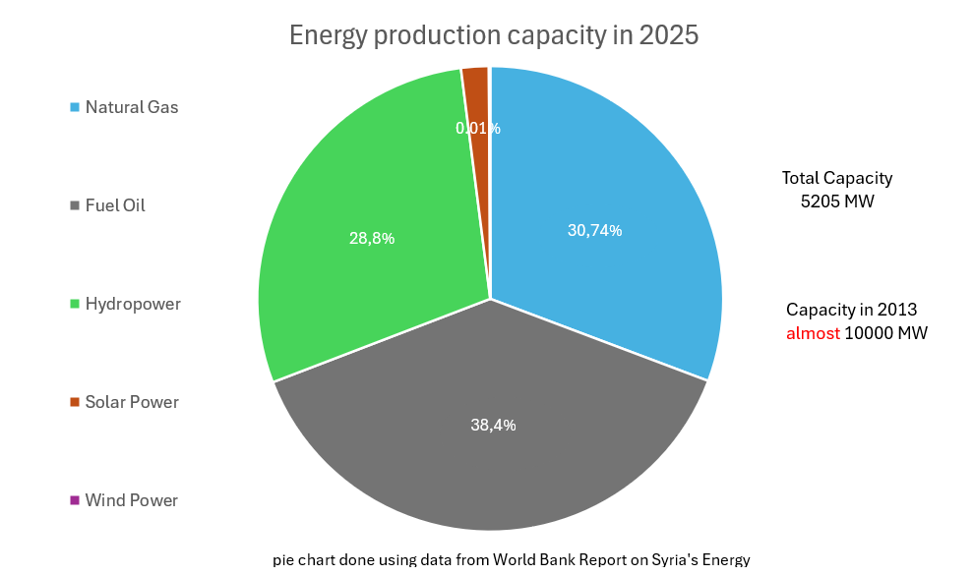
Energy profile in syria
Grid regulation of a maximum allowable percent of 30 % for certain region
to maintain grid stability and avoid frequency and voltage fluctuations
According to IPP tender
Recommendation choose a site with high suitable demand and relevant portion of conventional power plants sizing storage system with respect to these risks of Black out
World Bank. (2011). Syria energy sector assessment and recovery plan (Report No. 499230ESW0P11010). World Bank Group

Slide 23
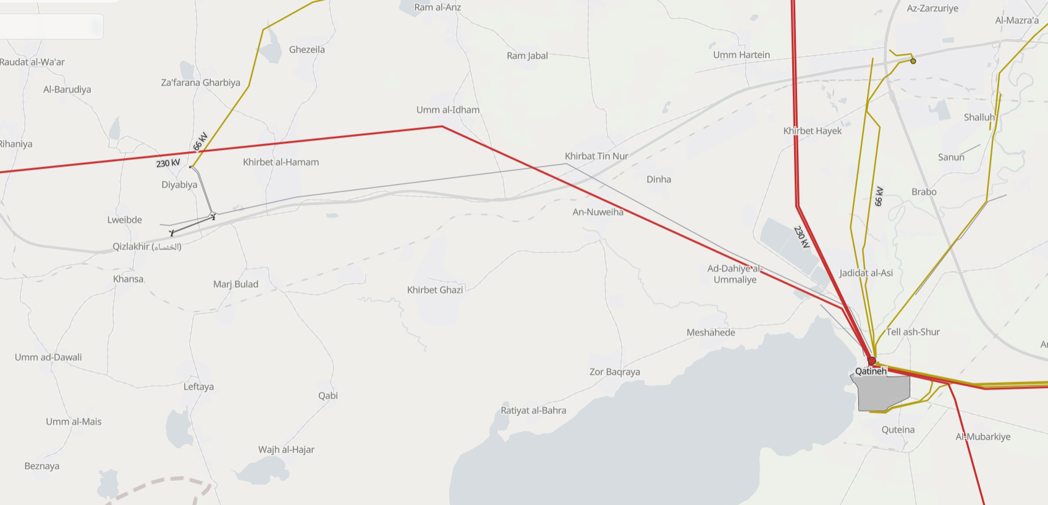
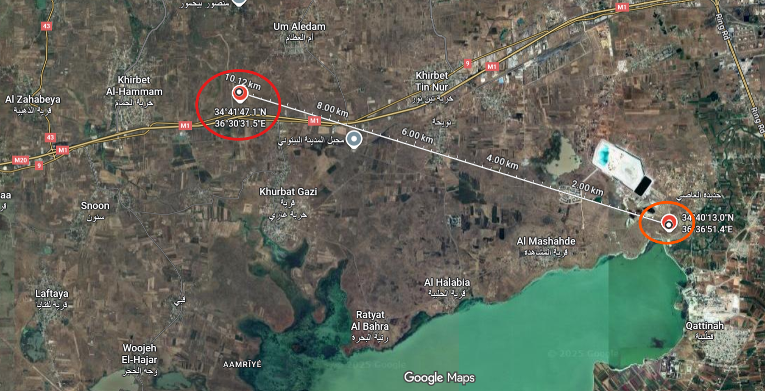
Site Comparison
Um_Aledem
Qattinah
2*2.5 Mw WT

Slide 24
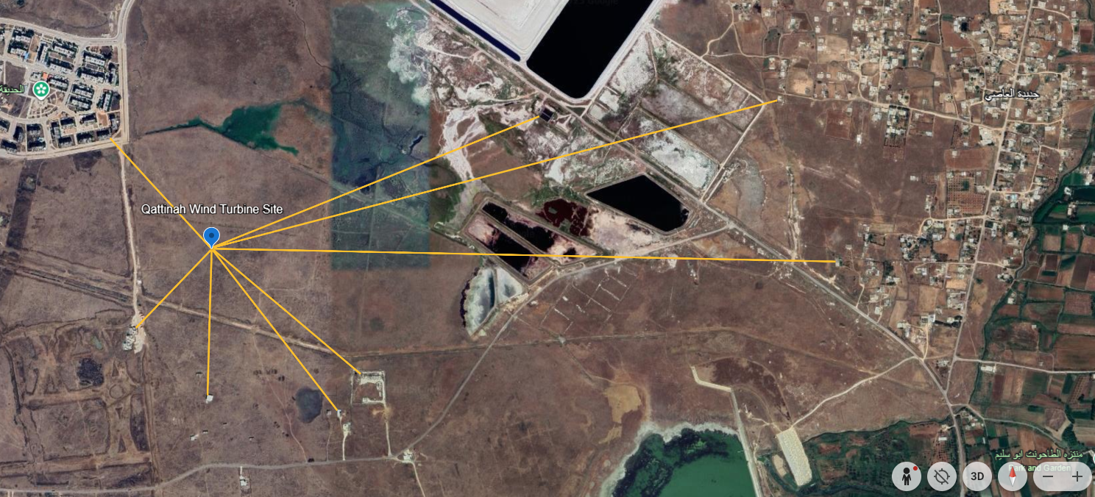
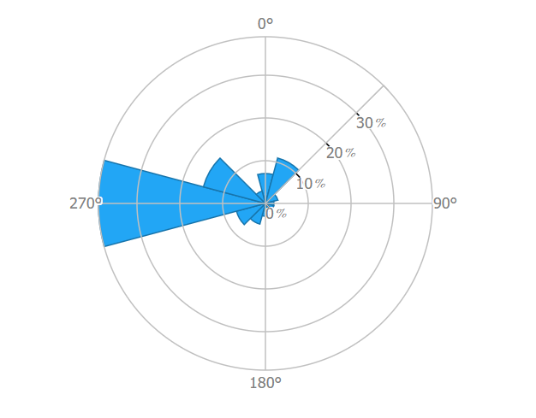
OLD Distance Analysis– Qattinah
Final Turbine Location: 34°40'25"N
36°35'44"E
Building | Distance [m]
Building A | 440 m
(Building B)* | 1 041 m
Building C | 1 724 m
Building D | 1 845 m
Building E | 577 m
Building F | 603 m
(Building G)* | 428 m
(Building H)* | 321 m
B
C
A
D
H
E
G
F
* Not sure about the building
Figure 2: Distances in Qattinah [GoogleEarth]
Ahmed Sallam
Notes:
Shows the distances to the surrounding buildings.
In general the distance is longer to the surrounding buildings, especially in the main wind dirction, which is cruicual!
Regarding the buildings A, the shaddow flicker will be a problem, but only in the morning ours.
With the buildings F-H, I am not sure if they are in use. I assume its for farmers or so.
In my opinion its the better side now. Only the amount of water resources could be a major problem, but according to the soil analysis it will not be a problem!

Slide 25
Update Distance Analysis– Qattinah
Final Turbine Location: 34°40'22"N
36°35'59"E
B
A
C
Building | Distance [m]
Building A | 800 m
Building B | 767 m
Building C | 1 396 m
Building D | 1 469 m
Building E | 577 m
Building F | 629 m
B
C
A
D
D
H
F
E
G
E
F
Barns or ruins
Figure 3: Distances in Qattinah [GoogleEarth]
Ahmed Sallam
Notes:
Shows the NEW distances to the surrounding buildings.
In general the distance is longer to the surrounding buildings, especially in the main wind dirction, which is cruicual!
The red numbers are critical but not in the main wind direction.
Within the red circles we assume that these are not actual buildings, looks like barns or ruins

Slide 26

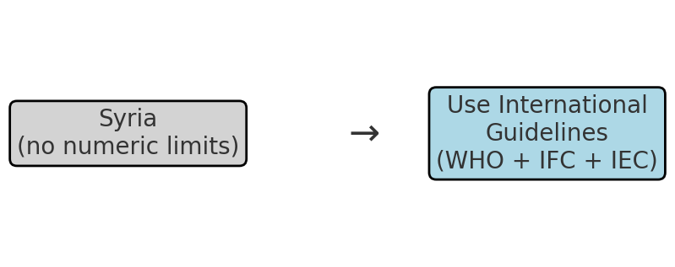
Noise Regulation Context — Syria
• Syria’s Environment Law No.12 (2012) forms the main legal framework for environmental protection.
• No publicly available numeric limits for wind turbine noise are specified in current Syrian legislation.
• Therefore, international best practices are used for project assessment (WHO, IFC, IEC).
References: Environment Law No.12 (2012); WHO Environmental Noise Guidelines (2018); IFC EHS Guidelines (Wind Energy); IEC 61400‑11.
References: SIEMENS
Ahmed Sallam

Slide 27
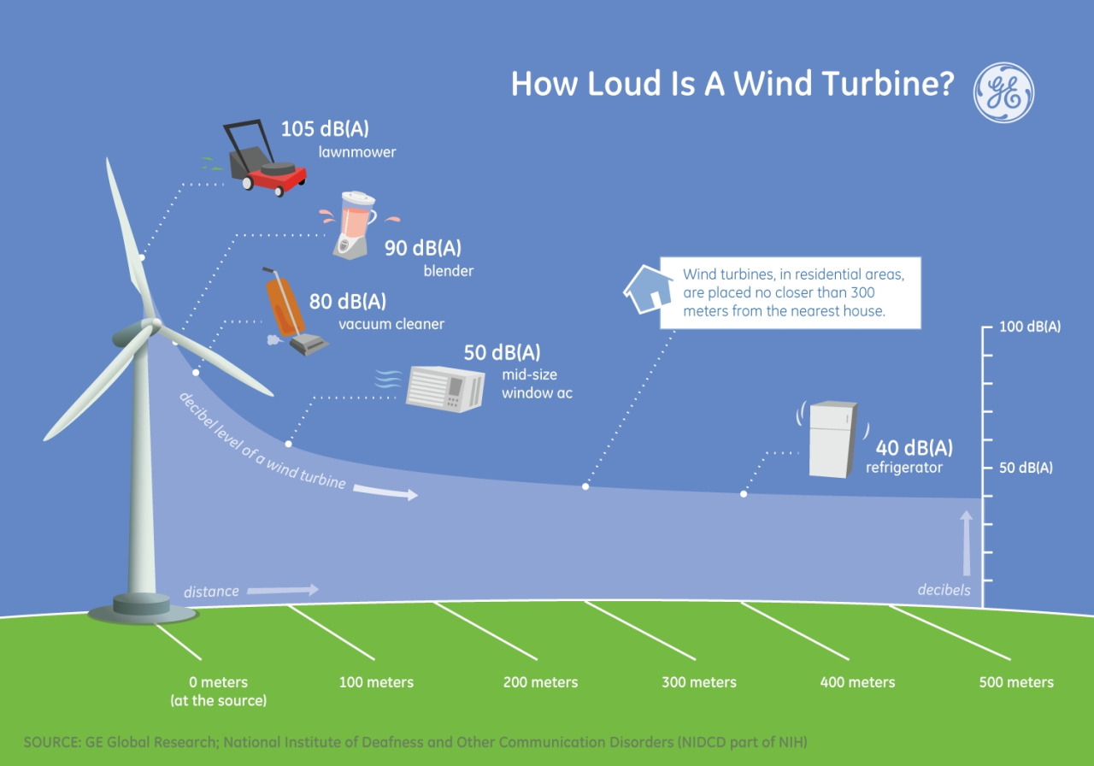
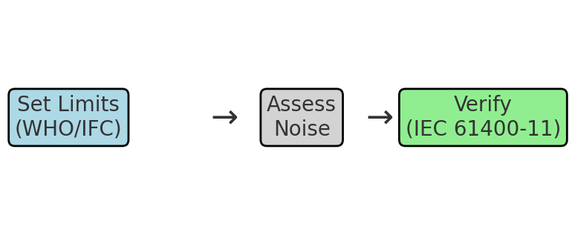
Recommended Noise Criteria for Wind Turbine Project
Proposed Project Criteria:
• Health-based limits: ≤ 45 dB Lden (day-evening-night) and ≤ 40 dB Lnight.
• Alternative rule: Background + 3 dB(A), whichever is stricter.
• Verification method: IEC 61400‑11 (turbine noise measurement).
References: WHO Environmental Noise Guidelines (2018); IFC/World Bank EHS Guidelines; IEC 61400‑11.
Ahmed Sallam

Slide 28
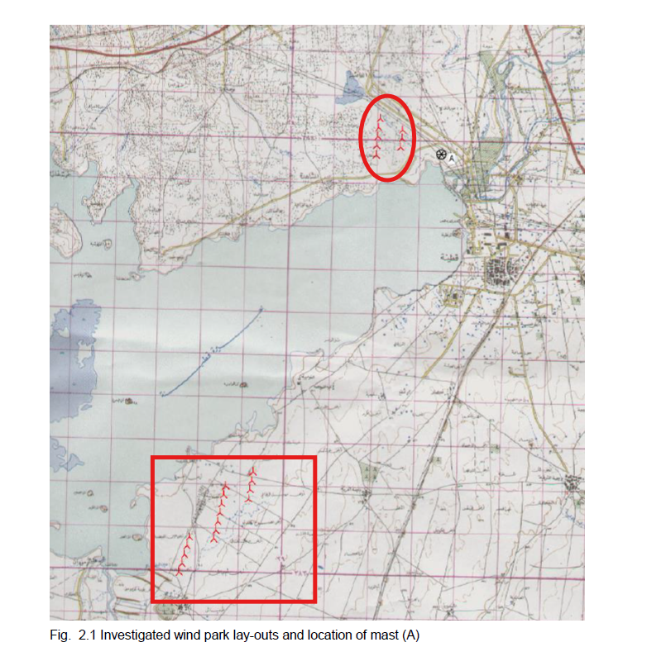
Site final decision
1
Prefeasibility study of Decon company in Qattinah :
the north shore scenario of 8 turbines with 1,5 MW
2. the south scenario of 16 turbines of 1,5 MW each
Hub height of 64.7 m
Final Turbine Location: 34°40'22"N
36°35'59"E
Complex soil condition
the tests of the WAsP (Wind Atlas Analysis and Application Program) model have shown: that there are some shortages in the prediction of the height profile.
2
the limitation in the roughness description
2. general climatic effect caused by the lake
Ahmed Sallam

Slide 29
CRITICAL ASSESSMENT OF THE RESULTS
Located within a tender area with government-owned land, simplifying permitting and land acquisition.
Situated in a safe grid zone, ensuring compliance with the limit of 30% renewable energy penetration under the IPP scheme.
Proximity to the high-voltage grid, reducing connection costs and losses.
Confirmed soil suitability after discussion with the geotechnical team, ensuring the feasibility of foundation reinforcement for turbines reaching 120 m hub height.
Ahmed Sallam

Slide 30
References
[1] Global Wind Atlas, Global Wind Atlas. [Online]. Available: https://globalwindatlas.info/en/. [Accessed: Sep. 17, 2025].
[2] Google Earth, Google Earth Web. [Online]. Available: https://earth.google.com/web/@34.29977563,36.68817928,1384.78342427a,853580.17318904d,35y,0h,0t,0r/data=CgRCAggBOgMKATBCAggASg0I____________ARAA. [Accessed: Sep. 17, 2025].
[3] Google Maps, Google Maps. [Online]. Available: https://www.google.com/maps. [Accessed: Sep. 17, 2025].
[4] Open Infrastructure Map, OpenInfraMap. [Online]. Available: https://openinframap.org/#10.04/33.2058/36.2058. [Accessed: Sep. 17, 2025].
Wind power plant site selection: A systematic review https://doi.org/10.1016/j.rser.2021.111293/

Slide 31
Weekly report: Load & Dynamics
Week number: 03
Date: 14/10/2025
Supervisor: Mr. Manjock
Group members: Md Aman, Arham Memon, Paresh Nakum
Presented By - Paresh Nakum
14/10/2025
Md Aman, Arham Memon, Paresh Nakum
Optimus Syria

Slide 32
Agenda
Environmental Inputs (Syria-Relevant)
Simulated Loads
OpenFAST Load Simulation Inputs
TurbSim Input File (XY.inp)
OpenFAST Inflow File (XY_Inflow.dat)
Wind Time Series Variations
Conceptual Illustration
Future Plans
14/10/2025
Paresh Nakum
Load & Dynamics Team/ Optimus Syria

Slide 33
Environmental Inputs
Parameter | Typical Range / Note
Mean wind speed hub | 8-10 m/s
Turbulence intensity | 0.16
Shear exponent (α) | 0.10–0.25
Extreme gusts | From ERA5 or IEC EOG model
Air density | 1.25 kg/m³
Seismic hazard | Moderate–high (Dead Sea / East Anatolian faults)
Other | Dust storms, temperature swings, corrosion factors
*data and research from wind farm group
14/10/2025
33
Paresh Nakum
Load & Dynamics Team/ Optimus Syria

Slide 34
Simulated Loads
Simulation Type | Goal | Typical IEC Case
Normal Operation | Evaluate fatigue and performance | DLC 1.1, 1.2,
Extreme Wind Conditions | Check survival loads | DLC 1.3, 6.1
Startup/ Shutdown/ Fault | Check transient response | DLC 2.1, 2.2, 2.3
Parked/ Standby | Idle or a storm survival | DLC 6.3
*DLC (“Design Load Case”) defines wind, wave, and control conditions to simulate.
Source: DNVGL-ST-0437:2016
14/10/2025
34
Paresh Nakum
Load & Dynamics Team/ Optimus Syria

Slide 35
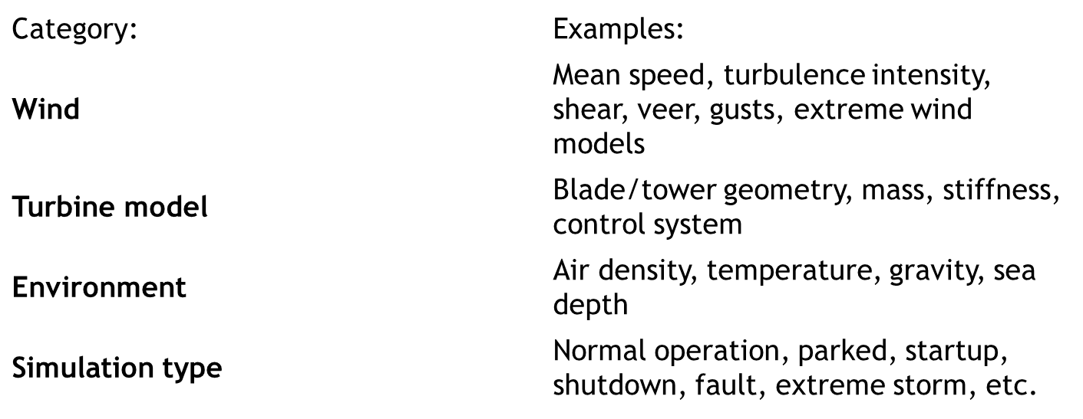
OpenFAST Load Simulations
Parameter needs to be analyzed
14/10/2025
35
Paresh Nakum
Load & Dynamics Team/ Optimus Syria

Slide 36
TurbSim Input File
Changes in the reference NREL TurbSim according to Optimus Syria Project
Parameter | NREL 5 MW (126 m) | Optimus Syria 5 MW (160 m)
Hub Height (m) | 90 | 120
Rotor Diameter (m) | 126 | 160
Mean Wind Speed, URef (m/s) | 8.0 – 11.4 | 7.5
Turbulence Intensity (TI) | 0.12 | 0.16
Shear Exponent | 0.14 | (0.12 – 0.18)
Roughness Length, Z₀ (m) | 0.1 | 0.03 (Not Fixed)
Turbulence Model | IECKAI (Kaimal) | IECKAI / Mann
Length Scale, Lᵤ (m) | 75 | (85 – 100)
Time Step, DT (s) | 0.05 | 0.05
Simulation Time (s) | 600 | 660
Grid Size (vertical × lateral) | 41 × 41 | (41 × 41 or 51 × 51)(Not Fixed)
14/10/2025
36
Paresh Nakum
Load & Dynamics Team/ Optimus Syria

Slide 37
OpenFAST 3.0 Inflow File
Parameter | NREL 5-MW (126 m) | Optimus Syria 5-MW (160 m)
Rated Power | 5 MW | 5 MW
Rotor Diameter | 126 m | 160 m
Hub Height | 90 m | 120 m
Rated Wind Speed | 11.4 m/s | 7.5 m/s
Rated Rotor Speed | 12.1 rpm | 9–10 rpm (Not Fixed)
File Reference | Baseline | XY.inp
Flow Angle | 0 degree | 5-10 degree
Gearbox Ratio | 97:1 | ~100:1 (varies by design)
Tip Speed | 80 m/s | 80 m/s
Power Coefficient (Cₚ,max) | 0.482 | ~0.48–0.50
14/10/2025
37
Paresh Nakum
Load & Dynamics Team/ Optimus Syria

Slide 38
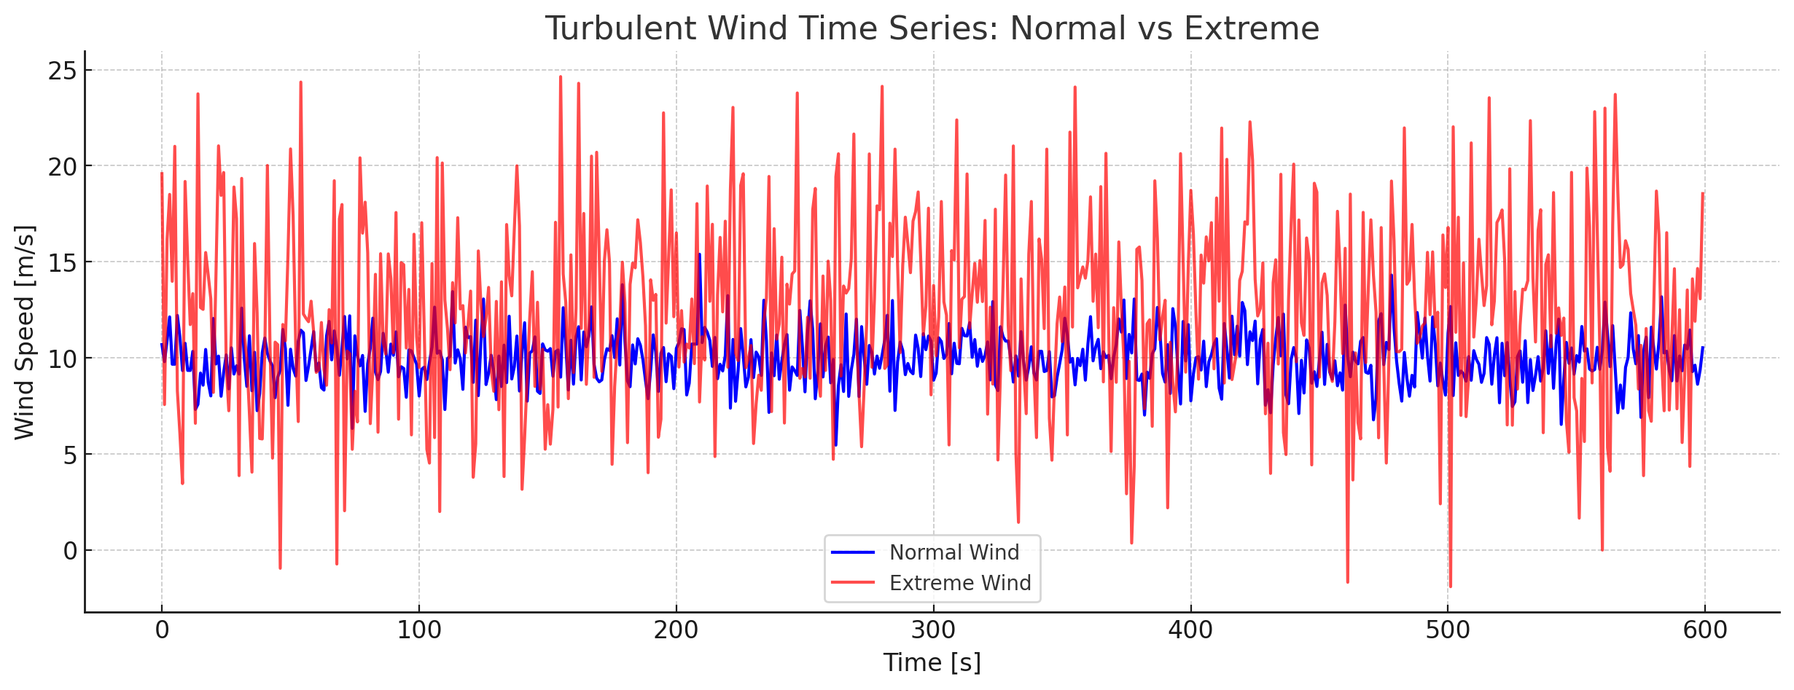
Wind Time Series
Blue line: normal wind - fluctuates gently around 10 m/s, representing typical turbulence.
Red line: extreme wind - higher mean speed (≈12 m/s) with strong fluctuations and sudden gusts (spikes), representing rare or storm-like conditions.
You can clearly see how extreme wind files have both larger turbulence intensity and short-duration spikes, while normal wind remains relatively smooth.
*Image from other source
14/10/2025
38
Paresh Nakum
Load & Dynamics Team/ Optimus Syria

Slide 39
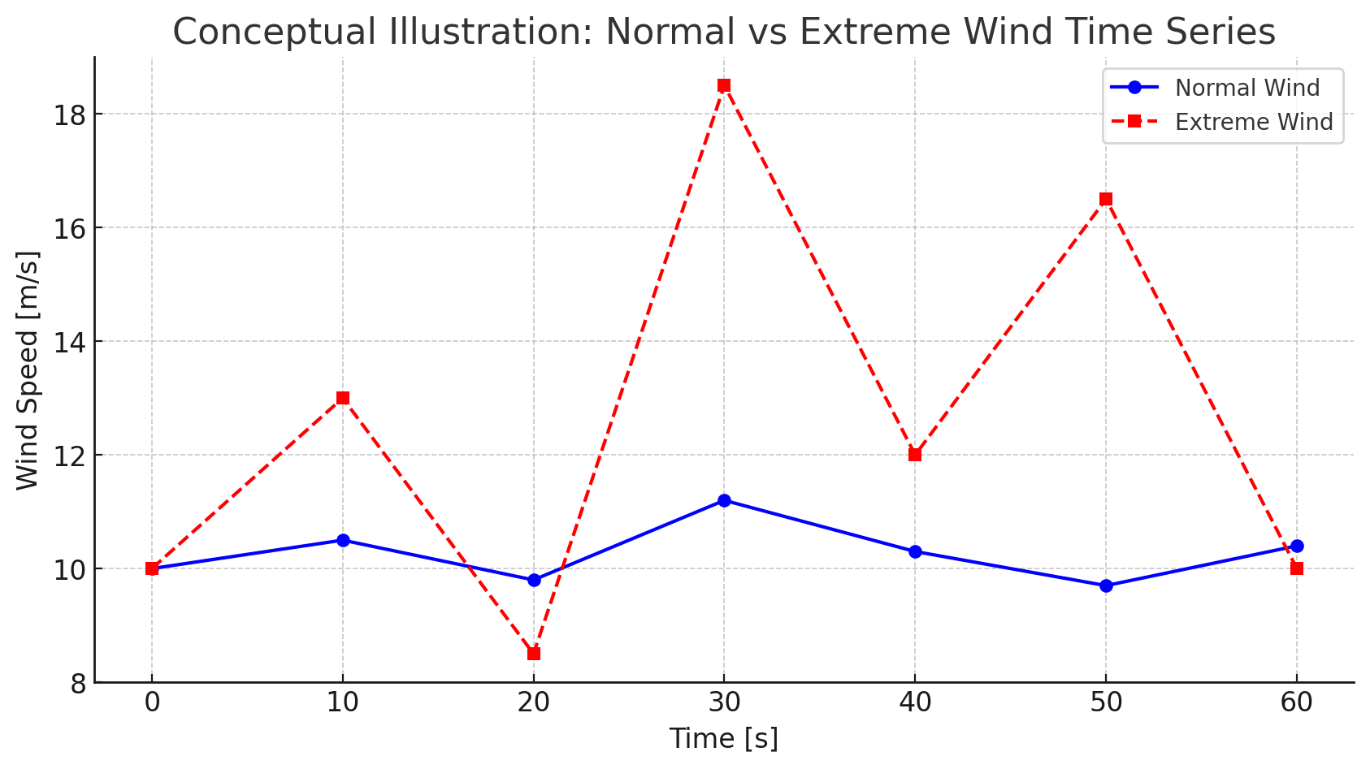
Conceptual Illustration
Time (s) | Normal wind (m/s) | Extreme wind (m/s)
0 | 10.0 | 10.0
10 | 10.5 | 13.0
20 | 9.8 | 8.5
30 | 11.2 | 18.5 (gust)
40 | 10.3 | 12.0
50 | 9.7 | 16.5 (gust)
60 | 10.4 | 10.0
Normal wind file: looks like a slightly wavy signal around 10 m/s, with small, random fluctuations (turbulence intensity ≈ 10–15%).
Extreme wind file: shows violent spikes and sharp transitions — gusts up to +80% of the mean wind speed, with short correlation times.
Blue line (Normal Wind): smooth variations around 10 m/s - typical design conditions.
Red Line (Extreme Wind): sharp peaks & strong fluctuations representing gusts& severe turbulence events.
14/10/2025
39
Paresh Nakum
Load & Dynamics Team/ Optimus Syria

Slide 40
Future Plan
In the next week We’ll
Configure OpenFast
Create Turbulent wind Field (precise data) with TurbSim
Start With Other parameters DLC
Connect with controller group for simulations
14/10/2025
40
Paresh Nakum
Load & Dynamics Team/ Optimus Syria

Slide 41
References
Load Reports of the OPTIMUS projects
Loads and site conditions for wind turbines, DNVGL-ST-437,Edition November 2016
TurbSim, OpenFAST & NREL 5 MW
Load Simulation Seminar 2025 by Mr. Manjock
14/10/2025
41
Paresh Nakum
Load & Dynamics Team/ Optimus Syria

Slide 42
Weekly report: Feedback Controller
Week number: 03
Date: 13/10/2025
Supervisor: Prof. Dr.-Ing. David Schlipf
Group members: Mirza Dincer, Saurabh Pankaj Jha
Presenter: Saurabh Pankaj Jha

Slide 43
List of Contents
Tasks of the Week
Wind field generation
Calculation for Hub height
Simulation Settings
Results
Conclusion
Saurabh Jha - 770271

Slide 44
Tasks of the Week
Running the wind field generation script in MATLAB for the IEA 3.4MW turbine.
Reference Hub height calculation.
Running examples of DLC 1.2 simulations.
Saurabh Jha - 770271

Slide 45
Wind Field Generation
It is the process of creating spatially and temporally varying representations of wind velocities over an area of interest, particularly for control applications.
Use TurbSim to simulate turbulent wind patterns.
Input file for Turbsim consist of turbine/model specifications, meteorological boundary conditions etc.
Provides information about incoming wind speed, direction, and turbulence, which are the primary drivers of turbine loads and power production.
Enables advanced simulation, allowing the assessment and optimization of controller strategies before deployment.
Saurabh Jha - 770271

Slide 46
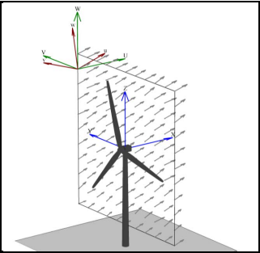
Wind Field Generation
Things to consider for input file.
Between 30 and 40 grid points.
One grid point should be at 0,0​.
Grid height and grid width should be at least 10% larger than diameter.
+1 should be added to number of grids in input file to complete the grid.
Example Wind Field from TurbSim
[1]
Saurabh Jha - 770271

Slide 47
Wind Field Generation
Wind Model Specifications for DLC 1.2.:
Turbulence Class: IEC 'A' (High turbulence intensity).
Wind Type: Normal Turbulence Model (NTM).
Simulation Duration: 600-second analysis time
UsableTime: Should be set to ‘ALL’.
Scale IEC: Should be set to ‘2’, in order simulation has right mean and standard deviaton.
TimeStep: Should be at least 2 times of the highest eigenfrequency, 5-10 times are better.
Saurabh Jha - 770271

Slide 48
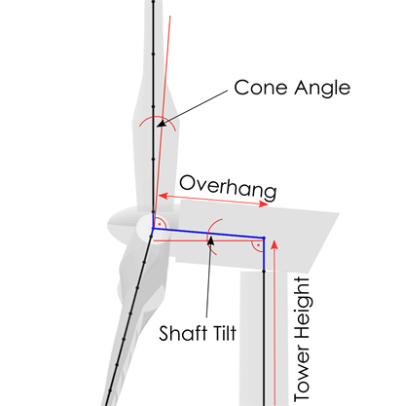
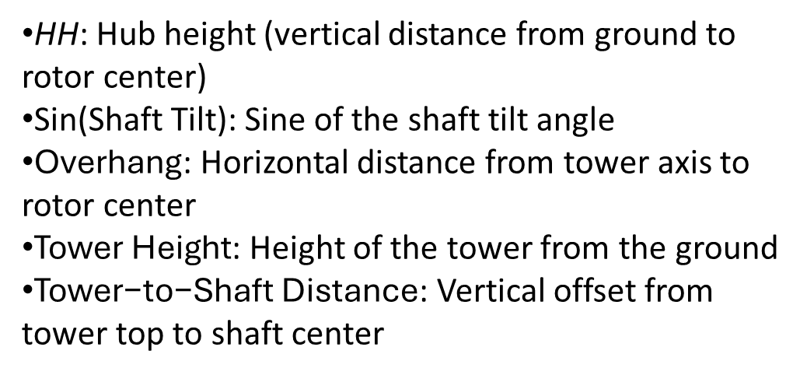
Calculation for Hub Height
Important for OpenFAST and Turbsim Input file.
HH=sin(Shaft Tilt)×Overhang+Tower Height+Tower to-Shaft Distance
HH: Hub height (vertical distance from ground to rotor center)
Sin(Shaft Tilt): Sine of the shaft tilt angle
$\text{Overhang}$: Horizontal distance from tower axis to rotor center
$\text{Tower} \text{Height}$: Height of the tower from the ground
$\text{Tower}\text{−}\text{to}\text{−}\text{Shaft} \text{Distance}$: Vertical offset from tower top to shaft center
[2]
Sketch from Qblade documentation
Saurabh Jha - 770271

Slide 49
Simulation Settings
30 seconds of simulation.
DLC 1.2 wind fields with average of 8 m/s, 10 m/s and 12 m/s.
Only enabled Rotor DOF and First fore-aft tower bending-mode DOF.
Set initial conditions of rotor speed, pitch angle, tower top positions. So that turbine starts in steady state.
Running only feedback controller, no Lidar-assisted controller.
Saurabh Jha - 770271

Slide 50
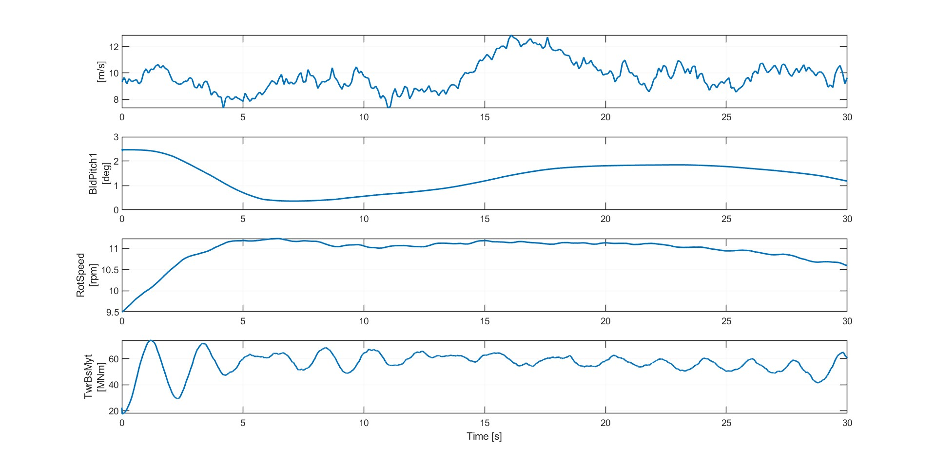
Result 1
Simulation results for IEA 3.4 MW with feedback control. 8 m/s wind field for DLC 1.2
Saurabh Jha - 770271

Slide 51
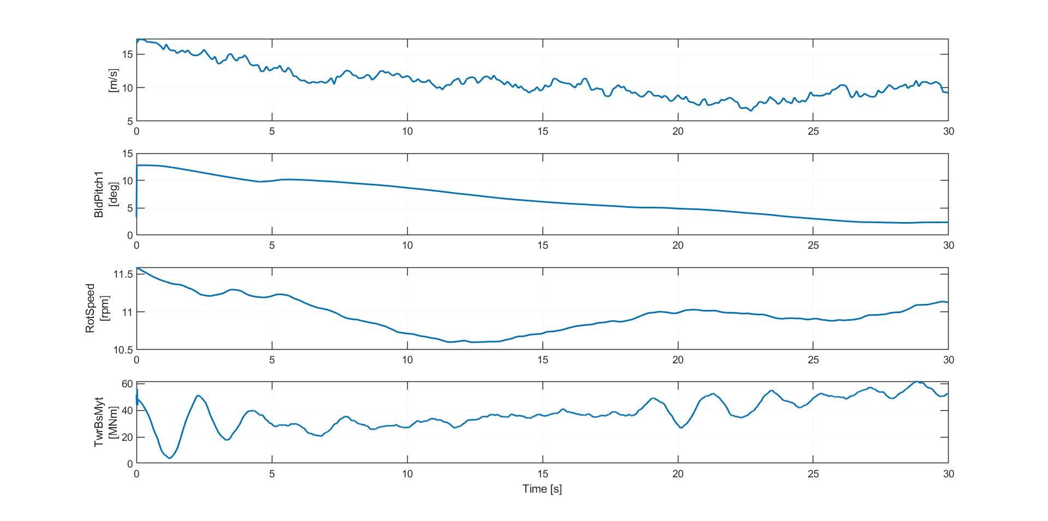
Result 2
Simulation results for IEA 3.4 MW with feedback control. 10 m/s wind field for DLC 1.2
Saurabh Jha - 770271

Slide 52
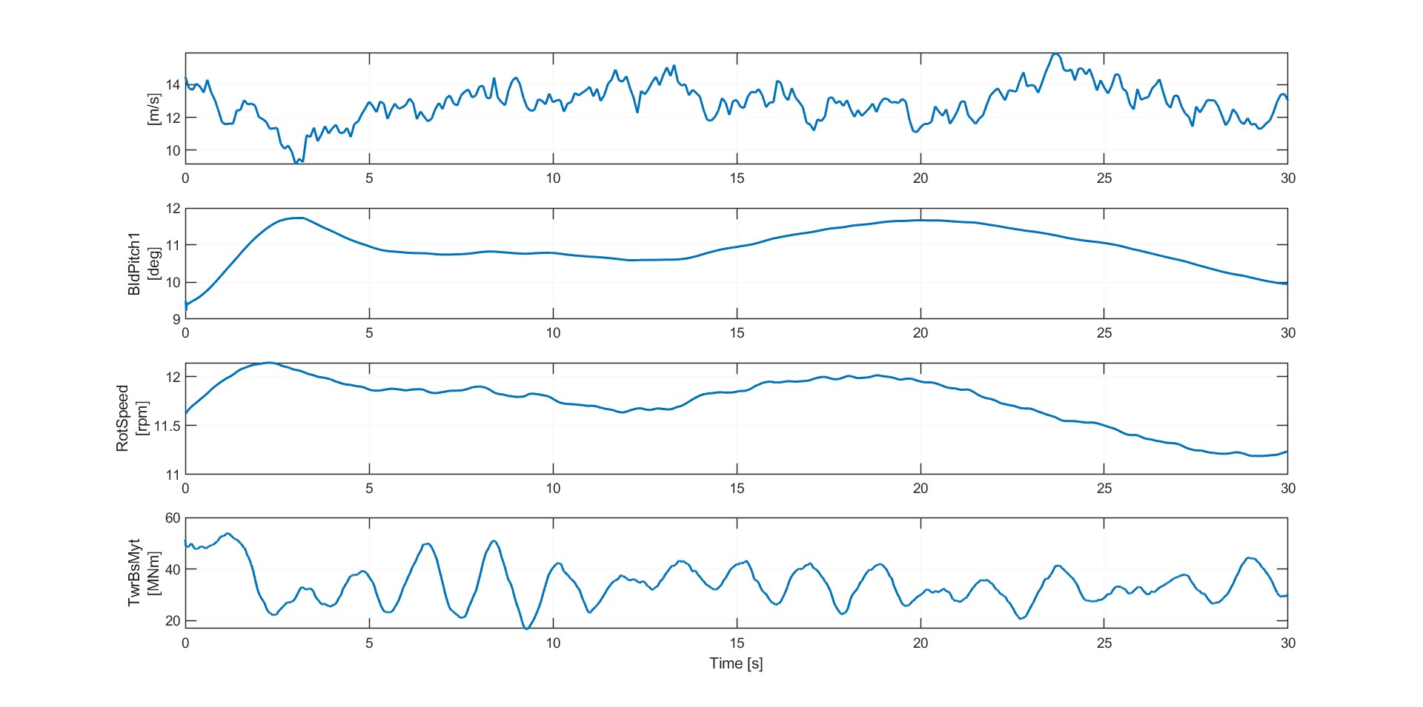
Result 3
Simulation results for IEA 3.4 MW with feedback control. 12 m/s wind field for DLC 1.2
Saurabh Jha - 770271

Slide 53
Conclusion
Successfully generated wind fields.
Run examples of DLC 1.2 simulation.
Next week:
Run full DLC 1.2 simulations, with different seeds, wind speeds and longer simulation time.
Understand and apply cost calculation for controllers.
Saurabh Jha - 770271

Slide 54
Bibliography – Feedback Controller
[1] “TurbSim User’s Guide v2.00.00,” Nrel.gov, 2025. https://www.nrel.gov/docs/libraries/wind-docs/turbsim_v2-00-pdf.pdf?sfvrsn=5a0a30f8_1
[2] “Aerodynamic Turbine Design — QBlade Documentation 2.0.6.4 documentation,” docs.qblade.org. https://docs.qblade.org/src/user/turbine/aerodynamic.html
Saurabh Jha - 770271

Slide 55
Report : Lidar Assisted Controller
Date: 14/10/25
Supervisor: prof. David Schlipf
Group members: Midhun Kanichattu Venu,Hesham Mahmoud

Slide 56
List of contents
Bladed control interface (pre-v4.4)
Swap array communication
Handshaking and synchronization
Data exchange flow
Midhun Kanichattu Venu 770588

Slide 57
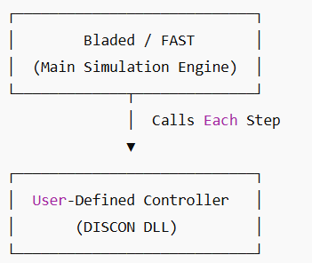
Bladed Control Interfaces
Who calls whom
Bladed is the main simulation engine
Calls the User-Defined Controller (DLL or EXE) each timestep
Controller reads inputs → computes → returns outputs
How Signal Transfer Works
DLL Case: uses array avrSWAP in memory (faster, direct)
EXE Case: uses shared binary file discon.swp
Each record = one signal (4 bytes)
Record 1 used for handshaking (0 = wait, 1 = ready, -1 = end)
Midhun Kanichattu Venu 770588

Slide 58
Handshake Process (Record 1)
Bladed Simulation
Flow:
Controller writes 0 → ready
Bladed sets 1 → data ready
Controller reads, writes outputs, sets 0 again
Simulation continues
Csharp
AvrSwap Array
User Controller Dll
Output
Bladed
Midhun Kanichattu Venu 770588

Slide 59
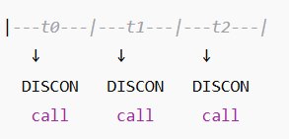
Array Data Exchange
Record | Direction | Description | Units
2 | In | Current time | s
4 | In | Blade 1 pitch angle | rad
20 | In | Generator speed | rad/s
45 | Out | Commanded pitch | rad
47 | Out | Commanded torque | Nm
Execution Timing
Midhun Kanichattu Venu 770588
Midhun Kanichattu Venu 770588

Slide 60
Link to OpenFAST
OpenFAST runs the full turbine simulation.
Calls ServoDyn, which manages control interfaces.
ServoDyn uses the Bladed Legacy Interface (BLI) to link with control DLLs.
Case 1: ServoDyn → ROSCO.dll (standard feedback control).
Case 2: ServoDyn → Wrapper.dll → calls LDP.dll, FFP.dll, and ROSCO.dll.
Enables combined feedforward, feedback, and lidar-based control.
Midhun Kanichattu Venu 770588

Slide 61
DLL Comunication
Lidar Simulator provides the following signals to the LDP.DLL in the swayArray
Table with record and description
LDP.DLL provides the following signals to the FFP.DLL in the swayArray
Table with record and description
FFP.DLL provides the following signals to the Rosco.DLL in the swayArray
Table with record and description
Graph
OpenFAST Lidar Simuator
LDP
FFP
Rosco
Midhun Kanichattu Venu 770588

Slide 62
Git and Github
Introduction to Git & GitHub
Git: A version control system to track changes in code/projects
GitHub: A cloud platform to store, share, and collaborate on Git repositories
Helps manage versions, collaborate with teams, and keep history of all changes
Common Operations: Clone, Commit, Push, Pull
Clone → Copy repository from GitHub to local machine
→ Command: git clone <repository_URL>
Commit → Save changes locally as a snapshot
→ Commands: git add git commit -m "Describe your change"
Midhun Kanichattu Venu 770588

Slide 63
Git and Github
Push → Upload local commits to GitHub
→ Command: git push origin main
Pull → Fetch and merge latest updates from GitHub
→ Command: git pull origin main
Getting Latest Files from GitHub:
1. git clone <repo> → First-time download
2. git fetch → Check for updates
3. git pull → Download & merge changes
Midhun Kanichattu Venu 770588

Slide 64
Git And Github
Sharing Your Code:
1. git add .
2. git commit -m "Message"
3. git push origin main
Team Collaboration:
1Create a branch → git checkout -b new-feature
2 Fork repos to contribute to others’ projects
3 Submit Pull Requests for code review
Midhun Kanichattu Venu 770588

Slide 65
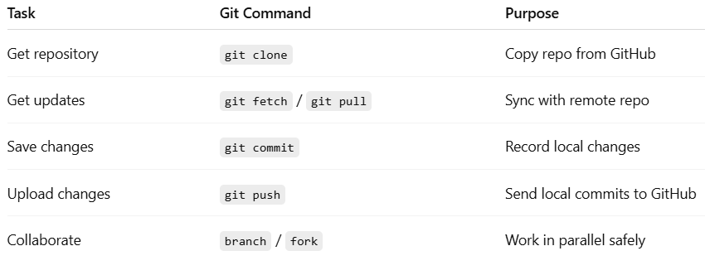
Git And Github
Midhun Kanichattu Venu 770588

Slide 66
Bibliography – Lidar Assisted controller
Hansen, M. Aerodynamics of Wind Turbines, 3rd Ed., Routledge, 2015.
Ingram, G. Wind Turbine Blade Element Momentum Theory, 2011.
Bossanyi, E. Controller Design for Variable-Speed Wind Turbines, Wind Engineering, 2000
Midhun Kanichattu Venu 770588

Slide 67
Rotor Blade Design
Week: 03
Date: 14.10.2025
Supervisor: Prof. Dr. rer.nat. Alois Schaffarczyk
Presented by – Jay Pandya
Team members : Jay Pandya, Harsh Panchal, Kandarp Pathak, Daniyal Sikander

Slide 68
List of contents
Overview
Tip speed
Tip speed ratio (TSR)
Why it is important?
Thickness distribution
Jay Pandya Matriculation Number 770198

Slide 69
Overview
Rated power – 5 MW
Rotor Diameter - 160 m
Wind Speed - 9.3 m/s (as per management team)
Hub diameter – approx 3-4m (not decided yet)
Hub height - 120m
Rated Rotor Speed – 8.36-9.55 rpm (if rotor radius is 80m)
Blade length – 80-83m
Jay Pandya (770198)

Slide 70
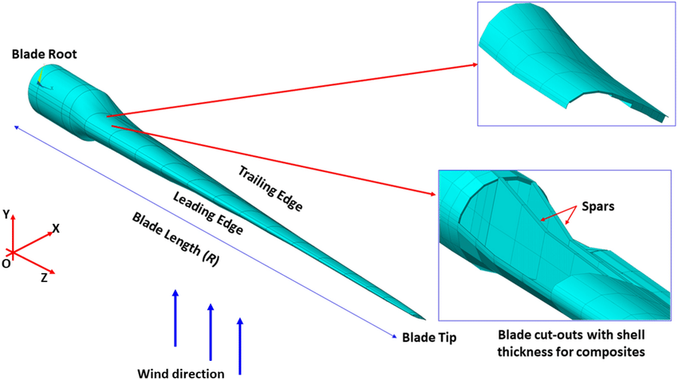
Tip Speed
Tip speed is the linear velocity of the blade tip as it rotates through the air.
Formula: Vₜ = ω × R
Where:
• Vₜ = Tip speed (m/s)
• ω = Angular velocity (rad/s)
• R = Rotor radius (m)
We have assumed 70-80 m/s.
Final value 85 m/s
Jay Pandya (770198)

Slide 71
Tip Speed Ratio (TSR)
Tip Speed Ratio (λ) is the ratio of the blade tip speed to the incoming wind speed.
Formula: λ = Vₜ / V_{w}
Where:
• λ = Tip speed ratio
• Vₜ = Tip speed (m/s) which we have assumed 80 m/s
• V_{w} = Wind speed (m/s) which is 9.3 m/s
TSR = 85/9.3
TSR ≈ 8.6
Jay Pandya (770198)

Slide 72
Why it is important?
High tip speed: Increases power but causes higher noise and stress on blades.
Low tip speed: Reduces noise but decreases efficiency.
Optimal TSR (6–10) ensures balance between efficiency, noise, and structural integrity.
Proper design helps maximize power coefficient (Cp).
Jay Pandya (770198)

Slide 73
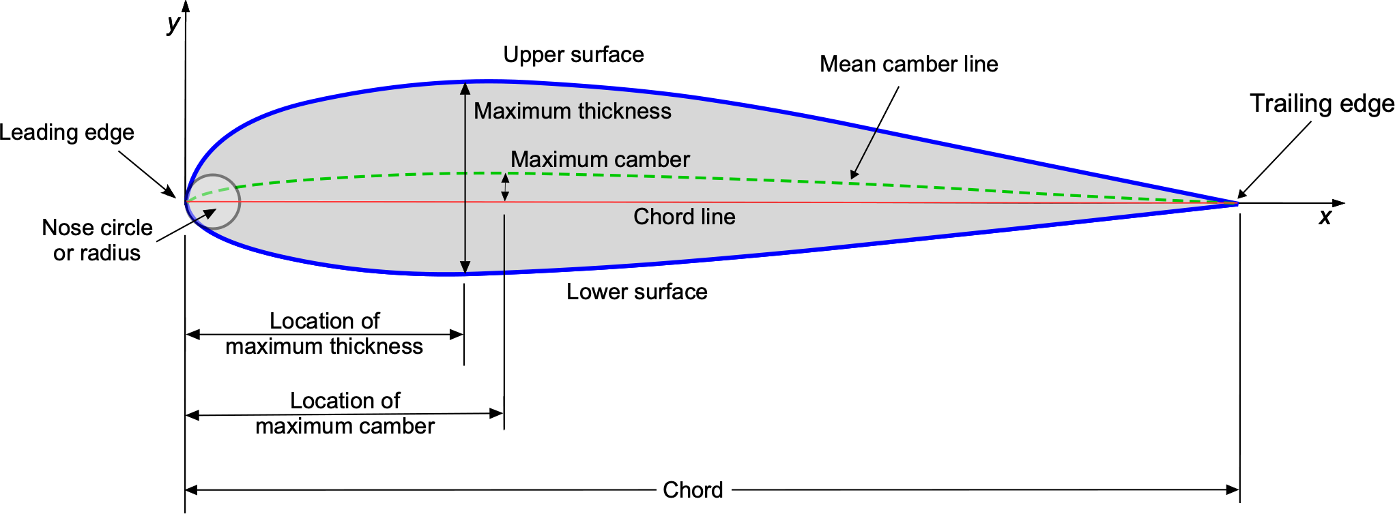
Thickness Distribution
Thickness distribution describes how the blade’s cross-sectional thickness changes from root to tip.
Balances aerodynamic performance and structural strength.
Root: 35–40% thickness – for structural strength.
Mid-section: 25–30% thickness – transition region.
Tip: 15–18% thickness – aerodynamic, reduces drag.
Jay Pandya (770198)

Slide 74
Next Week’s Work
To Determine exact numerical values for Tip Speed Ratio and Thickness Distribution for the 5 MW wind turbine.
Gather necessary aerodynamic and structural data for calculations.
We will discuss with the professor Schaffarczyk regarding next steps.
Jay Pandya (770198)

Slide 75
Bibliography
Burton, T., Jenkins, N., Sharpe, D., & Bossanyi, E. (2021). Wind Energy Handbook (3rd ed.). Wiley.
Hau, E. (2013). Wind Turbines: Fundamentals, Technologies, Application, Economics (3rd ed.). Springer.
Schaffarczyk, A. P. (2014). Understanding Wind Power Technology: Theory, Deployment, and Optimisation. Wiley.
DNV GL. (2016). Design and Analysis of Wind Turbine Blades – Guideline for Certification.
National Renewable Energy Laboratory (NREL). (2009). Wind Turbine Design Guideline DG03: Blade Structural Testing.
Global Wind Energy Council (GWEC). (2024). Global Wind Report 2024.
Jay Pandya (770198)

Slide 76
Team 5 – Rotor Blade Structures
Week No - 3
Date - 14.10.2025
Supervisor - Dr. Laurence Alhrshy
Presented by – Mithun Shetty
Team Members - Bhima B Masare, Anudeep Allanki, Dongsuk Kim, Mithun Shetty

Slide 77
Contents
Rotor Blade Structures Team Time line
Fixing the length of Blade
Fix the nodes along the length of Blade
Blade Root Diameter Details
Data needed to proceed further
Tasks planned for upcoming weeks
Bibliography
Mithun Shetty

Slide 78
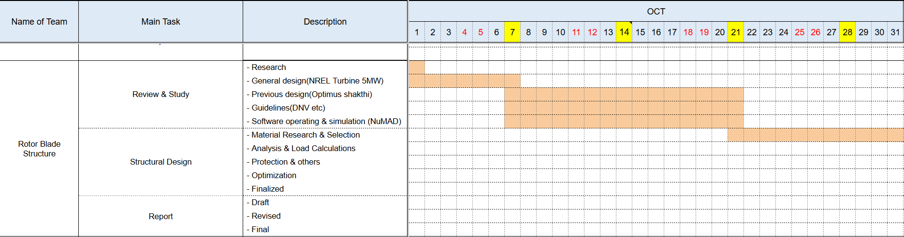
1. Rotor Blade Structures Team Time line -
1.1 Team Time line for Month October -
Mithun Shetty

Slide 79
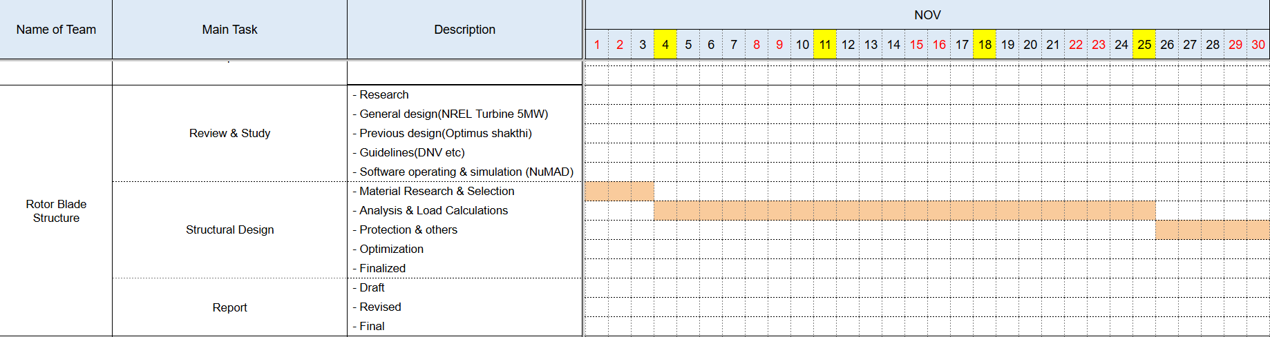
1. Team Time line
1.2 Team Time line for Month November -
Mithun Shetty

Slide 80
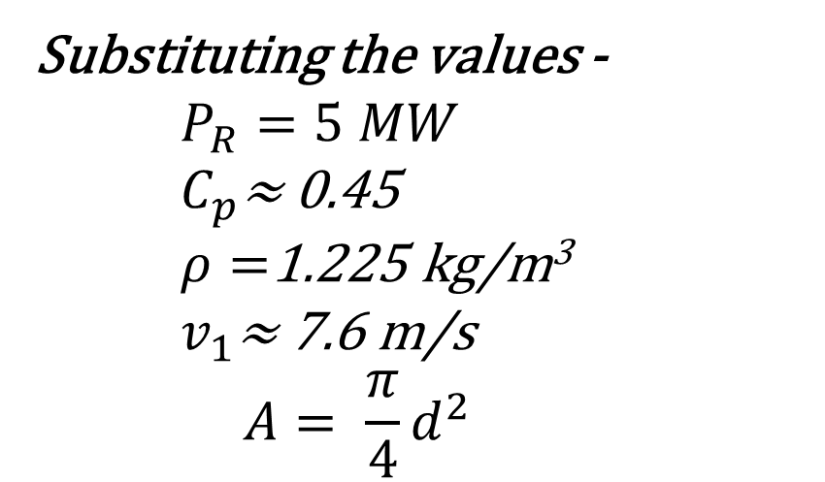
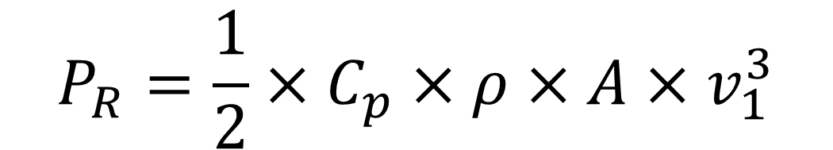
2. Fixing the length of Blade
$$P_{R}=\frac{1}{2}×C_{p}×ρ×A×v_{1}^{3}$$
Substituting the values -
$$P_{R}=5 MW$$
$C_{p}\text{≈}$ 0.45
$ρ=$1.225 kg/m³
$v_{1}\text{≈}$7.6 m/s
$$A= \frac{π}{4}d^{2}$$
We get –
D ≈ 160 m
R ≈ 80 m
Mithun Shetty

Slide 81
3. Fix the nodes along the length of Blade -
As per Optimus Shakthi 2024 the number of nodes is equal to 11 (R = 87 m)
According to NREL 5MW the number of nodes is 17 (R = 63 m).
As per the length of Optimus Syria Rotor Blade (R = 80 approx.) it is decided by the Aerodynamics Team.
Using above data we are doing calculation to accommodate feasible number of nodes to provide both structural strength and good aerodynamic lift as well.
We are yet to fix the number of nodes and the distance between the nodes.
Once we get the actual blade geometry from the Aerodynamics Team. We will decide the above mentioned factors.
Mithun Shetty

Slide 82
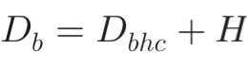
4. Blade Root Diameter Details
As per our assumptions based on Optimus Shakthi we calculated the blade root diameter.
Using the formula,
here,
D_{b} = External (outer) Blade Diameter
D_{bhc} = Bolt Hole Circle diameter
H = Root Thickness
D_{bhc} = 3.6 m (as per Optimus Shakthi)
H = 125 mm (as per standards to prevent the bearing failure from the T Bolts)
D_{b} = 3.725 m (approx.)
Mithun Shetty

Slide 83

5. Chord Length Formula -
$$c\left(r\right)=\frac{1}{z}⋅\frac{8}{9}⋅\frac{2πR}{C_{L}}⋅\frac{1}{λ_{D}⋅\sqrt{{\left(λ_{D}⋅\frac{r}{R}\right)}^{2}+\frac{4}{9}}}$$
here, c(r) = Chord Length (m)
z = No. of Blades (m)
R = Rotor Radius (m)
C_{L} = Lift Coefficient
λ_{D} = Designed Tip Speed Ratio
Mithun Shetty

Slide 84
5. Data needed to proceed further
As per the instructions from the Management Team We have decided the no. of air foils from 11 to 17 approx. as mentioned in the last slide.
So If the length of blade changes the distance between two nodes is altered only once we get the final blade geometry (2D & 3D Model)
For this, We fix the Blade Geometry using NREL & Optimus Shakthi for sometime to start with dealing the structural aspects
The final Laminate thickness (H) will be calculated once we get the final blade geometry from Aerodynamics Team
Mithun Shetty

Slide 85
6. Tasks planned for upcoming weeks -
Material Selection
Spar Cap & Shear Web Thickness
Develop Blade Model in NuMAD
Analysis with Precomp
Iterate and refine the design
Mithun Shetty

Slide 86
Bibliography
Definition of a 5 MW/61.5m Wind Turbine Blade Reference Model by Brian R. Resor, Sandia National Laboratories, California, USA
Definition of a 5 MW Reference Wind Turbine for Offshore System Development, J. Jonkman, S. Butterfield, W. Musial, and G. Scott, National Renewable Energy Laboratory, USA
Reports from Optimus Shakthi 2024
Mithun Shetty

Slide 87
Weekly report: Electrical Drivetrain
Week number: 4
Date: 14/10/2025
Supervisor: Prof. Dr.-Ing. Saiju
Group members: Aiswarya Vijayan, Vishranti Shivajirao Patil , Girish Mahadeo Padalkar, Cristina Milene Vergara Hernandez

Slide 88
List of contents
Concept of a converter in a wind turbine
Main function of a converter
Types of Converters
Our recommendation
How the converter is connected
IGBT overview
Conclusion & Next Steps
Aiswarya Vijayan
Electrical Drive Train/ Optimus Syria

Slide 89

1.Concept of a Converter in a Wind Turbine
Source : https://www.researchgate.net/publication/315044381
Control_techniques_for_losses_reduction_in_wind_turbine_DFIG
Aiswarya Vijayan
Electrical Drive Train/ Optimus Syria

Slide 90
2.Main function of a converter
Power Conversion
Control of Power Flow
Voltage & Frequency Regulation
Protection & Grid Compliance
System Efficiency
Components:
Rotor-Side Converter (RSC): Controls torque and generator speed.
DC-Link Capacitor: Maintains stable DC voltage.
Grid-Side Converter (GSC): Manages grid connection and reactive power.
Aiswarya Vijayan
Electrical Drive Train/ Optimus Syria

Slide 91


3.Types of converters
Source : www.academia.edu/35403755/ Power_Electronics_Converters_for_Wind_Turbine_Systems
Aiswarya Vijayan
Electrical Drive Train/ Optimus Syria

Slide 92
Partial-scale back-to-back Voltage-Source Converter (VSC) — Rotor-Side Converter (RSC) + DC-link capacitor + Grid-Side Converter (GSC), IGBT-based, with grid-side LCL filter. (Converter rated ≈ 25–30% of machine power → ~1.25–1.5 MW rotor-converter rating) Why this choice? — Key justifications 1. Cost & weight efficient 2. High energy capture 3. Proven, industry standard
4.Our recommendation
Aiswarya Vijayan
Electrical Drive Train/ Optimus Syria

Slide 93


5.How the Converter is Connected
Aiswarya Vijayan
Electrical Drive Train/ Optimus Syria

Slide 94

6.IGBT Overview
IGBT (Insulated Gate Bipolar Transistor) combines MOSFET input and BJT output features.
Used as a high-efficiency switch in converters for AC-DC and DC-AC conversion.
Advantages: high voltage/current capacity, fast switching, low losses, robust design.
Aiswarya Vijayan
Electrical Drive Train/ Optimus Syria

Slide 95
7.Next Step
Planning:
align our milestone planning with the other teams
Technical:
Generator: more detailed estimation of dimensions (size & rotational speed), Cost.
Converter: detailed study of IGBT ,Signal used to control IGBT and estimate detailed data of converter.
Market Survey of Generator and converter.
Aiswarya Vijayan

Slide 96

Bibliography
[1] S. Müller, M. Deicke, and R. W. De Doncker, “Doubly fed induction generator systems for wind turbines,” IEEE Ind. Appl. Mag., vol. 8, no. 3, pp. 26–33, May–Jun. 2002.
[2] F. Blaabjerg and K. Ma, “Wind energy systems,” Proc. IEEE, vol. 105, no. 11, pp. 2116–2131, Nov. 2017.
[3] M. Liserre, R. Cárdenas, M. Molinas, and J. Rodríguez, “Overview of multi-MW wind turbines and wind parks,” IEEE Trans. Ind. Electron., vol. 58, no. 4, pp. 1081–1095, Apr. 2011.
[4] H. Polinder, J. A. Ferreira, and B. B. Jensen, “Trends in wind turbine generator systems,” IEEE J. Emerg. Sel. Topics Power Electron., vol. 1, no. 3, pp. 174–185, Sep. 2013.
[5] G. Abad, J. López, M. Á. Rodríguez, L. Marroyo, and G. Iwanski, Doubly Fed Induction Machine: Modeling and Control for Wind Energy Generation. Hoboken, NJ, USA: IEEE Press/Wiley, 2011.
[6] Infineon Technologies AG, “FF1500R17IP5 IGBT module datasheet,” Infineon Technologies, Munich, Germany, 2023. https://www.infineon.com/dgdl/Infineon-FF1500R17IP5-DataSheet-v02_01-EN.pdf.
[7] Vestas Wind Systems A/S, “V150-5.0 MW technical brochure,” Vestas, Aarhus, Denmark, 2023. https://www.vestas.com/en/products/5-mw-platform.
[8] ABB Group, “Converters and drives for wind power applications,” ABB, Zurich, Switzerland, 2024. https://new.abb.com/drives/industries/wind.

Slide 97
Weekly report: Grid Code Development
Week number: 3
Date: 14/10/2025
Supervisor: Prof. Dr.-Ing. Saiju
Presented by: Vijay Bogala / Josef Remberger

Slide 98
List of contents
Simulink simulation
Block Scheme
Simulation Results
German vs. Syrian grid code
Further work

Slide 99
1. Simulink simulation
Based on the “Wind Farm - Doubly-Fed Induction Generator (DFIG) Average Model” in MATLAB
Simulation Setup: Voltage Dip of 0.2 pu in a period of 0.5 sec. with a 5 MW DFIG
Simulation Target: Analysis of Low Voltage Ride-Through (LVRT) Behavior

Slide 100

1-i. Block Scheme
Block Scheme of a 5 MW DFIG; Modified from [1] Gagnon, 2025

Slide 101

1-ii. Simulation Results
(Voltage, Current, active and reactive Power on the converter output; Created with Simulink; 12/10/2025)

Slide 102

1-ii. Simulation Results
(DC-link voltage, rotational speed of the rotor, active and reactive Power on the grid side; Created with Simulink; 12/10/2025)

Slide 103


2. German vs. Syrian grid code
Voltage Profile Recovery of Wind Generators During and After a voltage sag; German grid code / E. O-Netz GmbH [2]; (11/10/2025)
Voltage Profile Recovery of Wind Generators During and After a voltage sag; Syrian grid code / PETE [3]; (11/10/2025)

Slide 104


2. German vs. Syrian grid code
Minimum requirements for a non-synchronous machine in voltage control; German grid code / E.ON-Netz [2]; 2018
Minimum requirements for a non-synchronous machine in voltage control; Syrian grid code / PETE [3]; (11/10/2025)

Slide 105
3. Further work
More simulations in SIMULINK

Slide 106
Bibliography – Grid Code Development
[1] Wind Farm - Doubly-Fed Induction Generator (DFIG) Average Model. https://de.mathworks.com/help/sps/ug/wind-farm-dfig-average-model.html (accessed Oct. 12, 2025)
[2] E.ON-Netz GmbH / Grid connection rules for high and extra-high voltage. http://www.eon-netz.com/pages/ehn_de/Veroeffentlichungen/Netzanschluss/Netzanschlussregeln/ENENARHS2006de.pdf (accessed Oct. 12, 2025)
[3] SYRRIAN ARAB REPUBLIC / Ministry of Electricity / PETE / Transmission Grid Code, 2014 (accessed Oct. 11, 2025)

Slide 107
Rotor Hub And Pitch System Presenter: Muthu Thirunavukarasu
Group Members :
Dhruvin Kakdiya
Adharsh Pappinisseri Veedu
Muthu Thirunavukarasu
Syed Mohammed Sikandar
Week number : 03
Date: 14/10/2025
Supervisor: Prof. Peter Quell

Slide 108
List of contents
Paired comparison & Value benefit analysis of Pitch Control systems
Pitch Torque Assumption
Bearing types & Comparison
Market research to find a suitable Pitch drive
Muthu Thirunavukarasu

Slide 109
Paired comparison of Pitch Control Systems

Slide 110
Value benefit analysis (Weighted Evaluation)
Criteria | Weight (%) | Electrical Rating (R) | Electrical W*R | Hydraulic Rating (R) | Hydraulic W*R
Investment costs | 9 | 2 | 18 | 2 | 18
High torque | 22 | 3 | 66 | 1 | 22
Reliability | 24 | 3 | 72 | 3 | 72
Installation | 11 | 3 | 33 | 1 | 11
Operations at Hot Climate | 13 | 3 | 39 | 1 | 13
Weight | 6 | 3 | 18 | 2 | 12
Service friendliness | 11 | 3 | 33 | 2 | 22
Simple design | 4 | 2 | 8 | 3 | 12
Sum | 100 |  | 287 |  | 182

Slide 111
Total Weighted Scores:
Electrical Pitch: 287
Hydraulic Pitch: 182
Conclusion:
The Electrical Pitch system achieves a significantly higher weighted score, indicating it as the more suitable choice based on the selected evaluation criteria.

Slide 112
Pitch torque Assumption
𝑀=𝑀𝑧+𝑀𝑓𝑟𝑖𝑐+𝐽. 𝜑
𝑀𝑧 Acting wind torque = 363.15
𝑀𝑓𝑟𝑖𝑐 Friction torque of the pitch bearing = 88.271 kN/m
𝐽 Inertia of blade about the pitch axis
𝜑̈ Pitch angular acceleration
We have added a 50 KNm added as the safety factor
From all this data we get the required torque on the blade side as,
𝑀= 500 kN/m
Muthu Thirunavukarasu

Slide 113
Torque on Motor side
We took the values from Shakti as of now
Initial data:
Bolt Circle diameter of the blade (BCD) = 3600 𝑚𝑚
Gear Module (𝑚𝑛)=16 𝑚𝑚
Gear Pitch diameter (𝐷𝑓2min )=3474 𝑚𝑚
Number of teeth for the ring (𝑍𝑟𝑖𝑛𝑔 )=217
Number of teeth for the Pinion (𝑍𝑝𝑖𝑛𝑖𝑜𝑛 )=16
The transmission ratio of the bearing and the pinion:
𝑖𝑏𝑒𝑎𝑟𝑖𝑛𝑔=𝑍𝑟𝑖𝑛𝑔/𝑍𝑝𝑖𝑛𝑖𝑜𝑛
𝑖𝑏𝑒𝑎𝑟𝑖𝑛𝑔=13.56
Muthu Thirunavukarasu

Slide 114
The required torque in the pinion of the gearbox
𝑀𝑝𝑖𝑛𝑖𝑜𝑛 = 𝑀 / 𝑖𝑏𝑒𝑎𝑟𝑖𝑛𝑔 × 𝜂𝑟𝑖𝑛𝑔
𝑀𝑝𝑖𝑛𝑖𝑜𝑛= 38.41kNm
Total pitch system ratio is
𝑖𝑡𝑜𝑡𝑎𝑙= 𝑖𝑏𝑒𝑎𝑟𝑖𝑛𝑔 . 𝑖𝑔𝑒𝑎𝑟𝑏𝑜𝑥
𝑖𝑡𝑜𝑡𝑎𝑙 =2305.2
Obtaining the motor torque 𝑀𝑚 depends on the transmission ratio between the pinion and the blade bearing ring (𝑖𝑏𝑒𝑎𝑟𝑖𝑛𝑔) and the electric motor gearbox ratio (𝑖𝑔𝑒𝑎𝑟𝑏𝑜𝑥) .
Muthu Thirunavukarasu

Slide 115
𝑀𝑚=𝑀/ (𝑖𝑡𝑜𝑡𝑎𝑙)
𝑀𝑚= 217 Nm
So, We have found that the Motor torque would be 217 Nm from the 𝑀𝑧 given by the supervisor and the reference values from Optimus Shakti as of now.
Muthu Thirunavukarasu

Slide 116

Bearing types & Comparison
Triple-row roller bearing:
[1]
used as slewing bearings
consist of one radial roller row (to take radial load) and two axial roller rows (to handle axial loads in both directions or thrust)
very high capacity in all directions, relatively robust to high loads
Muthu Thirunavukarasu

Slide 117

Four-point contact ball bearing
[2]
a single-row angular contact ball bearing that is designed so each ball contacts the inner and outer rings in four points under combined loading.
It is Bidirectional Axial Load Capacity: They can support axial loads in both directions (push and pull), which is very helpful when the bearing must resist tilting moments or reverse loads.
Muthu Thirunavukarasu

Slide 118
Criteria | Triple row roller bearing | Double row 4-Point contact ball bearing
Contact area & Pressure | Line contact and low contact pressure | Point contact and high contact pressure
Contact angle | Axial row 90°and radial 0° | Initial Angle of contact 45°
Load bearing capacity | High due to large contact area | Comparatively low
Deformation | Low bearing ring deformation and ring separation under load | High bearing ring deformation and ring separation under load
Edge loading | Raceways edge loading occurs due to rollers can tilt during ring deformation, but it is low | High Edge loading occurs due to ball moves towards raceway edge under load
Radial load | Very low due to radial row of roller | High, which results in periodic ring stresses
Load carrying by raceways | At a time only one raceway carries the load | At a time both raceways carry the load
Manufacturing Complexity | Very high | Moderate
Moment load capacity | Very high
Wear Service Life | High due to line contact | Less due to point contact
Stiffness | High | Medium - Low
Axial load capacity | Very high | Moderate
Muthu Thirunavukarasu

Slide 119
We have chosen Triple ball bearing as of now because of their superior moment capacity and stiffness. It is also a choice because of its combined-load capacity. We want to discuss further more about the chosen type and produce calculations in the coming week.

Slide 120

Market research to find a suitable pitch drive
Nidec conversion
Since 1990, SSB Wind Systems has offered technology and know-how for onshore.
Advantages:
Pitch systems Range (750 kW to 15 MW)
Can be used in Hot, cold and normal climate version
Retrofittable
Highly flexible systems
Both battery and self-developed UltraCap backup solutions
Spare parts supply over the entire turbine lifecycle up to 30 years

Slide 121
Liebherr
over 25 years of experience in the wind industry
More than 25,000 wind turbines around the world are equipped with Liebherr components
Ensure continuous availability of components

Slide 122
Bibliography
1. http://xql-slewingbearing.com/3-3-wind-turbine-main-bearings.html
2. http://xql-slewingbearing.com/3-3-wind-turbine-main-bearings.html
3. DNV-RP-C203 / DNV-GL-ST-0376 (Rotor blades and pitch system design standards)
4. Large-diameter bearings for wind turbines” (Technical Paper 6002, 2022)
5. Timken – Wind-Energy Engineering Guide (2020)
6. Axial & Radial Load Capacity SKF (2023)
7. SKF Catalogue(2023)
8. https://share.google/Rk8wjXCYgb9xRfErD
Muthu Thirunavukarasu

Slide 123
Weekly Presentation: Rotor Bearing System
Week number: 03
Date: 14/10/2025
Supervisor: Prof. Quell
Group members: Divyesh Mistry, Venkata Sreekanth .K , Sreehari Padachery, Jill Sadariya
Presenter : Divyesh Mistry
Rotor Bearing System / Optimus Syria

Slide 124
Agenda
Task of the week.
Comparing the opinions.
Solution for Negative Aspects in Journal Bearings
Load equilibrium of 3-point suspension system.
Rotor Shaft design procedure.
GL Standards for Rotor Lock.
Recommended Rotor Lock.
Bibliography.
Divyesh Mistry
Rotor Bearing System / Optimus Syria

Slide 125
Task of the week
Contacted couple of bearing manufactures (SKF & Schaeffler) and some experts regarding spherical journal bearing suited for 5MW.
Analyzed Force-Momentum diagram of current rotor bearing system.
Studied Rotor Shaft calculation and Solution from previous year projects.
Divyesh Mistry

Slide 126




Comparing the opinions
1. Received feed back from bearing manufacturer in the UK “Michell Bearings”.
They suggested that a spherical journal bearing in bigger size may not an option.
They told to go for Tilting journal pads
2. One possible option as sliding bearing, could be the so called "white metal" bearings which are used in Gas turbines. Suggested by Howatech.
Source : Sajid, Z. (n.d.). Tilting pad. Scribd.
Source : Mangal Industry.
Divyesh Mistry

Slide 127
Solution for Negative Aspects in Journal Bearings
Negative Aspect | Cause / Limitation | Solution / Mitigation Strategy
High friction during startup (Hydrodynamic Bearing) | No hydrodynamic oil film at low or zero speed. | • Use hydrostatic lift assist system to supply pressurized oil during startup/shutdown. • Apply low-friction coatings (e.g., DLC, Triondur OC). • Use optimized bearing geometry to form film faster.
Load capacity depends on rotational speed (Hydrodynamic Bearing) | Oil film thickness builds up only with shaft rotation. | • Combine hybrid design: hydrodynamic + hydrostatic support. • Use variable viscosity oils or active lubrication control.
System complexity (Hydrostatic Bearing) | Requires external pump, filters, piping, controls. | • Integrate compact, modular pump units inside nacelle. • Use smart monitoring systems for pressure and flow. • Employ reliable self-contained lubrication cartridges.
Divyesh Mistry

Slide 128
Solution for Negative Aspects in Journal Bearings
High CAPEX (Hydrostatic Bearing) | Expensive pumps, control systems, and precision components. | • Use shared lubrication systems for multiple bearings. • Optimize bearing design and materials (e.g., polymer liners, ceramic coatings). • Focus on life-cycle cost savings—less downtime offsets higher CAPEX.
High OPEX (Hydrodynamic Bearing) | Frequent oil maintenance and monitoring required. | • Implement automated lubrication systems. • Use condition monitoring sensors (temperature, pressure, vibration). • Select long-life synthetic lubricants.
Complex external lubrication controls (Hydrostatic) | Separate systems for each bearing increase control difficulty. | • Use centralized lubrication and control systems. • Integrate digital predictive maintenance (IoT-based).
Divyesh Mistry

Slide 129


Three point suspension system
Source : Nam, J. S., & Nam, Y. Y. (2015). Influence of suspension stiffness on gearbox loads. J. Korean Soc. Manuf. Technol. Eng., 24(5), 514–520.
Source : Tan et al. (2019), Main shaft flexibility effects on wind turbine drivetrain..
Divyesh Mistry

Slide 130
Loads equilibrium of 3-point suspension system
F_{ZR}​
F_{ZA}​
F_{S}s
F_{G} s
F_{YR}​
F_{YA}​
M_{ZR}​
M_{YR}​
Rotor
F_{XR}​
F_{XA}​
Gear Box
Shaft C.G
M_{XR}​
Bearing A
L₁
L_{S}
L_{G}
Divyesh Mistry

Slide 131


Loads equilibrium of 3-point suspension system
Equilibrium for forces:
F_{AX}= - F_{RX}
F_{AZ} = - F_{RZ} + F_{RZ} + F_{S} + F_{G}
F_{AY}= - F_{RY}
F_{S} :Shaft gravitational force.
F_{G} : Gearbox gravitational force.
F_{A} : Radial Forces in (Y, Z) direction for Bearing A
F_{XR}​ : Force in X-direction at the hub
F_{YR} : Force in Y-direction at the hub
F_{ZR} : Force in Z-direction at the hub
M_{XR} : Moment in X-direction at hub
M_{YR} : Moment in Y-direction at hub
M_{ZR} : Moment in Z-direction at hub
Moment equilibrium about A
$\sum{M_{A}}=0$
M_{A}= - F_{RX}-F_{RZ}*l₁+F_{S}*(l_{S} -l₁) +F_{G} *(l_{G} -l₁)
Resulting force 𝐹𝐴,𝑟𝑒𝑠 acting at the main bearing point A
$$\sqrt{{FAZ}_{+}^{2}{FAY}^{2}}$$
F_{Aresult}=
Divyesh Mistry

Slide 132

Rotor Shaft Design Procedure
Step | Description, Symbols, and Key Formulas
1 – Define Input Data | Loads: $M_{y},M_{z}$= bending moments about Y & Z axes [N·m]; $M_{t}$= torque (torsional moment) [N·m]. Material: $R_{e,N}$= yield strength [MPa]; $E$= Young’s modulus [MPa]; $G=E/2\left(1+ν\right)$= shear modulus [MPa]; $ν≈0.3$(Poisson’s ratio for steel). Safety factors: $γ_{M}≈1.1\text{–}1.3$= material partial factor; $K_{d,m}$= size factor for yield. Fatigue data: $σ_{w,zd,N}$= fatigue limit at $N_{D}≈{10}^{6}$cycles; $k≈5$= S–N slope.
2 – Select Shaft Geometry | Assume hollow circular shaft: $D$= outer diameter [m], $d$= inner diameter [m]. Section properties: – $I=\frac{π}{64}\left(D^{4}−d^{4}\right)$→ second moment of area [m⁴] – $J=2I=\frac{π}{32}\left(D^{4}−d^{4}\right)$→ polar moment of inertia [m⁴] – $W=\frac{I}{D/2}=\frac{π}{32}\frac{D^{4}−d^{4}}{D}$→ section modulus for bending [m³] – $W_{p}=\frac{J}{D/2}=\frac{π}{16}\frac{D^{4}−d^{4}}{D}=2W$→ polar section modulus for torsion [m³].
Divyesh Mistry

Slide 133


Rotor Shaft Design Procedure
3 – Resultant Bending Moment | Combine bending axes: $M_{res}=\text{√}\left(M_{y}^{2}+M_{z}^{2}\right)$[N·m]. $M_{res}$= equivalent bending moment
.
4 – Nominal Stresses | $σ_{b,n}=M_{res}/W$(MPa) = nominal bending stress. $τ_{t,n}=M_{t}/W_{p}$(MPa) = nominal torsional shear stress.
5 – Apply Stress Concentration Factors | $σ_{b}=σ_{b,n}K_{t,b}$, $τ=τ_{t,n}K_{t,t}$. $K_{t,b}=1.5\text{–}3.0$; $K_{t,t}=1.2\text{–}2.5$. These produce local peak stresses.
6 – Combined von Mises Stress (ULS) | Equivalent stress: $σ_{v}=\text{√}\left(σ_{b}^{2}+3τ^{2}\right)$(MPa). $σ_{v}$= combined bending + torsion stress for ULS.
Divyesh Mistry

Slide 134

Rotor Shaft Design Procedure
7 – Design Yield Strength
8 – ULS Check
9 – Fatigue Limit State (FLS)
Divyesh Mistry

Slide 135

Rotor Shaft Design Procedure
10 – Allowable Fatigue Amplitude | Correction factors: $f_{m}$=mean-stress (0.7–1.0); $K_{d,σ}$=size (0.8–1.0); $K_{V}$=support (0.9–1.0); $K_{f,σ}$=notch (1.2–3.0); $K_{R,σ}$=surface (0.8–1.0). $S_{AK}=σ_{w,zd,N}f_{m}\frac{K_{d,σ}K_{V}}{K_{f,σ}K_{R,σ}}$(MPa).
11 – Fatigue Life Estimation | $N_{allowed}=N_{D}\left(S_{AK}/σ_{a,v}{\left.)\right.}^{k}\right.$; $N_{D}≈{10}^{6}$cycles, $k≈5$. Miner’s rule: $D=\sum{n_{i}}/N_{i}≤1.0$.
12 – Stiffness & Deflection Check | $θ=M_{t}L/\left(GJ\right)$[radians] = angle of twist. Bending deflection from beam theory using E and I. Check bearing & gearbox alignment.
Divyesh Mistry

Slide 136
GL Standards for Rotor Lock
GL (Germanischer Lloyd)(GL & IEC 61400-1)
Function: Secures rotor against rotation during maintenance, erection, or emergency.
Type: Form-fit design (e.g., pin-disc) preferred for reliability.
Load Capacity: Must withstand high transverse/gust loads (DLC 8.1, 8.2).
Strength Check: Verify shear, bending, and surface pressure; no plastic deformation.
Safety: Must prevent rotation even if brakes fail; safe manual release required.
Monitoring: Include non-contact or fail-safe position sensors.
Environment: Operate from –30 °C to +70 °C; corrosion-resistant (DIN ISO 12944).
Certification: Designed and tested per GL “Guideline for Certification of Wind Turbines.”
Maintenance: Periodic inspection and documentation required
Divyesh Mistry

Slide 137


Rotor Lock
Lock Pin Hydraulic Mechanism
Source : IPC WIND
Sibre Rotor Lock RLH 80
Sibre Rotor Locks to assist the braking functions on practically any rotor on the Wind Turbine market.
The Sibre Wind Turbine Rotor Lock RLH 80 is a hydraulically applied, form-closed lock for wind turbine rotors
Source : Optimus Shakti
Divyesh Mistry

Slide 138
Bibiliography
International Electrotechnical Commission (IEC). (2005). IEC 61400-1: Wind turbines – Part 1: Design requirements (3rd ed.). Geneva, Switzerland: IEC. ISBN 2-8318-8215-2. Available at: https://webstore.iec.ch/publication/6027Germanischer Lloyd (GL). (2010).
Guideline for the Certification of Wind Turbines. Hamburg, Germany: Germanischer Lloyd Industrial Services GmbH, Renewables Certification. Available at: https://www.dnv.com/services/guideline-for-the-certification-of-wind-turbines-1602
Tan, J., Zhu, C., Song, C., Han, H., & Li, Y. (2019). Effects of Flexibility and Suspension Configuration of Main Shaft on Dynamic Characteristics of Wind Turbine Drivetrain. Chinese Journal of Mechanical Engineering, 32(36).https://doi.org/10.1186/s10033-019-0348-4Nam, J. S., & Nam, Y. Y. (2015).
The Influence of Suspension Stiffness on the Gearbox Input Loads in a 3-Point Suspension Wind Turbine Drive Train. Journal of the Korean Society of Manufacturing Technology Engineers, 24(5), 514–520.https://doi.org/10.7735/ksmte.2015.24.5.514
Divyesh Mistry

Slide 139



Weekly report: Team Gearbox, Brake, Coupling
Week number : 03
Date: 14/10/2025
Supervisor: Prof. Peter Quell
Group Members :Nehang Jitendra Joshi,Santo Mazumder,Md Razaul Karim Rahat
Presented by -Nehang Jitendra Joshi
14-10-2025
Nehang Jitendra Joshi
Gearbox, Brake, Coupling

Slide 140
Agenda for 4th week
Team design
Basic overview about steps for design and calculation for the Gearbox
Svendborg brake as a choice
Overview for Coupling
Coordinate with internal group--
Rotor hub,Bearing,Machine bed (Mechanical Input)
Electrical Drivetrain Team (Mechanical Output)
Chapter | Responsible person
Introduction | All team members
Project order | All team members
Gearbox | Nehang
Rotor brake | Nehang+Rahat
Coupling | Nehang+Santo
14-10-2025
Nehang Jitendra Joshi
Gearbox, Brake, Coupling

Slide 141
Steps for Gearbox Concept Design
Define gear ratio according to required input & output speed.
Define gearbox input torque according to WTGs power and gearbox input speed.
Design a gear stage including number of stages, gear split ratio and gear macro design.
Selection of bearing according to chosen gear stages.
Design of housing.
Efficiency check and design of lubrication/ cooling system.
Finalise gearbox concept design.
14-10-2025
Nehang Jitendra Joshi
Gearbox, Brake, Coupling

Slide 142
Gearbox Design & Dimensioning
Number of Transmission Stages​
Shaft Arrangement​
Gear Type​
Module & Number of teeth​
Face width​
Material Selection
14-10-2025
Nehang Jitendra Joshi
Gearbox, Brake, Coupling

Slide 143
Gearbox system
Gearbox Calculations​
Based on IEC 61400-4 standards
Stages module m selection
Good storage housing
1st stage: m = ?
2nd stage: m = ?
3rd stage: m = ?
Higher torques require higher module
Dimensioning of the gearbox
IEC-61400-4
Dimensioning of the gearbox components
ISO 281
ISO 76
ISO 6336-1
Strength analysis
Modal analysis
Simulation
14-10-2025
Gearbox, Brake, Coupling
Nehang Jitendra Joshi

Slide 144
Gearbox system
Suppliers in the market:
Winergy
(Up to 8MW, eff. Of 96.5%, 2 stages low ratio gearbox)
Eickhoff
(Up to 4.8MW, 5 planet in one stage, 2 stages low ratio gearbox)
Wikof
(Up to 10MW, Flexible pin tech, 7 planets in one stage, 2 stages low ratio gearbox)
NGC
(Up to 8MW, 2 stages high ratio gearbox)
Moventas
(Up to 5MW, 2 stages low ratio gearbox)
14-10-2025
Nehang Jitendra Joshi
Gearbox, Brake, Coupling

Slide 145
Rotor Brake
Main Objective:
Overview of brake
Installation of brake
14-10-2025
Nehang Jitendra Joshi
Gearbox, Brake, Coupling

Slide 146




Rotor Brake
Energy supply methods:
Hydraulic
Electro-mechanic
Suppliers of locks:
Hilma Römheld
Svendborg Brakes
Suppliers of brakes
Svendborg Brakes
14-10-2025
Nehang Jitendra Joshi
Gearbox, Brake, Coupling

Slide 147


Rotor Brake
Main brake installation
Source: Optimus 200 XL Project
1 option
Installation on the HSS between gearbox and generator
Cons – mounting the generator on the frame, HSS coupling required
Source: https://www.svendborg-brakes.com/
2 option
Installation on the second generator shaft
possibility to mount the generator on the flange
14-10-2025
Nehang Jitendra Joshi
Gearbox, Brake, Coupling

Slide 148



Rotor Brake
Number of break calliper
Two brake callipers
One brake calliper
Svendborg Model BSAK 3000 caliper brake
Source: Optimus 200XL
Source: SMI Corporation
14-10-2025
Nehang Jitendra Joshi
Gearbox, Brake, Coupling
148

Slide 149


Rotor Brake
One brake calliper
Two brake callipers
Reaction force occurs
Possibility of torque
No balance
No generation of bearing reaction forces
Achieve balance
Source-Svendborg
Source-Svendborg
149
14-10-2025
Nehang Jitendra Joshi
Gearbox, Brake, Coupling

Slide 150
Coupling
Main Objective:
Layout design of coupling
Design criteria
LSS and HSS coupling
14-10-2025
Nehang Jitendra Joshi
Gearbox, Brake, Coupling

Slide 151


Coupling
Coupling Layout
Source: https://www.geislinger.com/en/products/product/compowind-coupling/
14-10-2025
Nehang Jitendra Joshi
Gearbox, Brake, Coupling

Slide 152
Coupling
Design Criteria
Torque transfer | Design criterion for a coupling is the torque and rotational speed it has to transfer during nominal operation | M_(N,lss) = (M_(N,gen) ∗i_gearbox)/η_gearboc
Permissible Elastic Vibratory Torque | nominal torque the coupling can transmit a vibratory torque | y="perm. elast vibratory torque" /"nominal torque" x="mean torque" /"nominal torque"
Torque overload protection | Limiting of torque after torque impulses due to electrical grid failures or generator short circuits | M_(breakdown ) = M_(N,lss)∗2.5
Permissible Misalignment | Axial Misalignment Radial Misalignment Angular Misalignment | From the calculations of tolerance
Loads deformation | Coupling housing has to sustain the loads of gearbox and generator which can results angular displacement | FEM and simulations with the finite element method (FEM)
14-10-2025
Nehang Jitendra Joshi
Gearbox, Brake, Coupling

Slide 153


Coupling
LSS Coupling
HSS Coupling
Source-Flender arpex
Source: https://www.geislinger.com/en/products/product/compowind-coupling/
14-10-2025
Nehang Jitendra Joshi
Gearbox, Brake, Coupling

Slide 154
Bibliography
Gearbox
(1) Previous year Optimus projects
(2) IEC-61400-4
Brake
(1)Svendborg brake- https://svendborg-brakes.com/products/hydraulic-brakes/active-brakes/
Coupling
(1)Previous year project documents
(2)Geislinger and flender coupling
https://www.flender.com/en/cas/document/asm_coupling/ziuP--x-S4WQYPTrtKZFUQ/Datenblatt.pdf?refConfigId=ziuP--x-S4WQYPTrtKZFUQ&refMlfb=2LC0371-2BA99-0AF0
https://www.geislinger.com/cms_images/content/Coupling_18.0.pdf
14-10-2025
Nehang Jitendra Joshi
Gearbox, Brake, Coupling

Slide 155
Weekly report: Machine Bed & Yaw System
Week # 3
Date: 14/10/2025
Supervisor: Prof. Quell Peter
Group members: Shoukat Abbas, Luksh Chawla, Sathishkumar Venkatachalam, Shrihari Kadam
14/10/2024
155
Luksh Chawla

Slide 156
Contents
3-Point Suspension Example Optimus-92
3-Point Suspension Design Requirements for Machine Bed and study model
The Free Body Diagram
The Objective & Scope of the Load Transfer Tool
Accurate Loads: From Input to Design Check
Yaw Bearing Diameter Estimation
Reference
14/10/2024
Luksh Chawla
2

Slide 157

3-Point Suspension Example Optimus-92
Suspension system 3-Point Suspension (Main Bearing + 2 Torque Arms) Main Bearing Double-row spherical roller bearing Yaw Bearing Four-point Roller bearing Yaw Systems Electric yaw drives + brakes + control loop[1]
14/10/2024
Luksh Chawla
Machine Bed & Yaw System/Optimus syria

Slide 158

Design Requirement for Bed Plate with 3-point Suspension
1. Rigid bedplate structure (steel cast/welded) with high fatigue strength. [2]
2. Supports must form a wide triangle for stiffness & stability.
3. Load transfer: rotor → bearing → gearbox → bedplate → tower.
4. Limit deflection & misalignment between shaft and gearbox.
5. Dynamic design – natural frequency above main excitation range.
6. Thermal & vibration isolation at each support.
3-point suspension concept from lecture drivetrain
14/10/2024
Luksh Chawla
Machine Bed & Yaw System/Optimus syria

Slide 159


Study Models For Bed plate - Optimus 92 LE with Hybrid Str.
Optimized Load Transfer: Main bearing and torque arm supports positioned above tower radius ensure efficient load flow into the tower with minimal deformation.
Structural Efficiency: Cast iron (EN-GJS-400-18-LT) bed with variable wall thickness and smooth transitions reduces stress concentration while maintaining stiffness and low weight.
Functional Integration: 5° tilt provides rotor tip clearance; welded rear truss with cross-girders improves torsional rigidity and simplifies maintenance access.
14/10/2024
5
Luksh Chawla
Machine Bed & Yaw System/Optimus syria

Slide 160


The Free Body Diagram
6
Machine Bed & Yaw System/Optimus Syria
14/10/2024

Slide 161
The Objective & Scope of the Load Transfer Tool
Objective:
To accurately calculate the Reaction Forces on the machine bed's three support points. We need these forces to size the structure. Input:
Rotor Loads (Fx​,Fy​,Fz​) from the Rotor Coordinate System. This is the raw data from the blades. Output:
Precise loads for the Main Bearing and Torque Arm Stands. These numbers are critical for 3-point suspension design. Value:
It ensures Statically Determinate Support by providing reliable force data for a strong, easy to level bed.
14/10/2024
7
Luksh Chawla

Slide 162

Accurate Loads: From Input to Design Check
Quick Results:
Enter rotor forces → get bed support reactions instantly.
Method:
Uses static equations (ΣF = 0, ΣM = 0) for load transfer.
Design Use:
Helps check torque-arm strength and main-bearing sizing.
[3]
14/10/2024
8
Luksh Chawla

Slide 163

Yaw Bearing Diameter Estimation
Yaw Bearing Diameter:
Influencing with tower top diameter. In contact with the “tower team”, the top diameter is likely to be around 3.5m.
$$\frac{D_{\text{tower}\text{,}\text{Syria}}}{D_{\text{tower}\text{,}\text{Shakti}}}=\frac{D_{\text{rotor}\text{,}\text{Syria}}}{D_{\text{rotor}\text{,}\text{Shakti}}}$$
$$D_{\text{tower}\text{,}\text{Syria}}=D_{\text{tower}\text{,}\text{Shakti}}×\frac{D_{\text{rotor}\text{,}\text{Syria}}}{D_{\text{rotor}\text{,}\text{Shakti}}}$$
$$D_{\text{tower}\text{,}\text{Syria}}=4.045 \text{m}×\frac{160}{178}=3.64 \text{m}$$
Geometric scaling: Final yaw bearing diameter must be verified by yaw-moment and contact-load calculations or supplier data, verification from Prof.
14/10/2024
Luksh Chawla
Machine Bed & Yaw System/Optimus syria

Slide 164
References
Report_Optimus92LE_Machinebed_Yawsystem_Rev1.pdf[1]
https://www.osti.gov/servlets/purl/13413[2] A Systems Engineering Analysis of Three-Point and Four-Point Wind Turbine Drivetrain Configurations," Wind Energy (2016).
3point_load_transfer_tool_v2.xlsx[3]
8
Machine Bed & Yaw System/Optimus Syria
14/10/2024

Slide 165
Weekly report: Tower structure
Week number: 03
Date: 14/10/2025
Supervisor: Prof. Faber
Group members: Ibrahim Mostafa, Mohammed Eldemerdash, Kirolls Ghaly
Speaker: Mohammed Eldemerdash (760137)

Slide 166
List of contents
Check Stress of the Tubular Steel structure.
Solutions to overcome transportation of the steel tower .
Handwritten load calculations and stress analysis.
14/10/2025
Group members: Ibrahim Mostafa, Mohammed Eldemerdash, Kirolls Ghaly
Tower structure team/ Optimus Syria

Slide 167

Loads calculations and stress analysis
Source: Prof. Dr.-Ing. Torsten Faber lectures
14/10/2025
Group members: Ibrahim Mostafa, Mohammed Eldemerdash, Kirolls Ghaly
Tower structure team/ Optimus Syria

Slide 168

Loads calculations and stress analysis
Assumptions
𝜌_{air}=1.225 kg/m³
𝜌_{steel}=7850 kg/m³
𝑔=10 m/s²
𝐷_{rotor}=160 m, 𝐷_{𝑜}=5.5 m, 𝑡=0.040 m
⇒ 𝐷_{𝑖}=5.42
Steel grade S355⇒ $σ\text{a}ll=345 {\text{N}\text{/}\text{mm}}^{2}$
𝐻_{tower}=118 m
ℎ_{hub}=120 m
𝑚ass_{rotor}=110,000 kg
𝑚ass_{nacelle}=240,000 kg
𝑀oment_{at the top}=33000 kN
𝑀oment_{at the base}=284000 kN
Reference to data assumptions:
-Load and Dynamic team
-https://www.nrel.gov/wind/data-tools
14/10/2025
Group members: Ibrahim Mostafa, Mohammed Eldemerdash, Kirolls Ghaly
Tower structure team/ Optimus Syria

Slide 169

Loads calculations and stress analysis
Step 1. Calculate vertical loads
At top section
$${Fv}_{1}=2400+1100=3500 \text{kN}$$
At bottom section
$$F_{V2}=\frac{π}{4}\left({Do}^{2}−{Di}^{2}\right)×ρ_{\text{steel}}×g$$
$$F_{V2}=\frac{π}{4}\left({5.5}^{2}−{5.42}^{2}\right)×7850∗10$$
$$F_{V2}=6355 \text{kN}$$
Total vertical load
$$V_{\text{total}}=3500+6355=9855 \text{kN}$$
14/10/2025
Group members: Ibrahim Mostafa, Mohammed Eldemerdash, Kirolls Ghaly
Tower structure team/ Optimus Syria

Slide 170

Loads calculations and stress analysis
Step 2. Section properties at base
$$A_{\text{tower}}=\frac{π}{4}\left({5.5}^{2}−{5.42}^{2}\right)=0.686 {\text{m}}^{2}$$
$$I_{\text{tower}}=\frac{π}{64}\left({4.8}^{4}−{4.74}^{4}\right)=2.55 {\text{m}}^{4}$$
Step 3. Base stress due to combined loading
$$σ=\frac{V_{\text{base}}}{A_{\text{tower}}}+\frac{M_{\text{base}}}{I_{\text{tower}}}×\frac{D}{2}$$
$$σ=\frac{9855}{0.686}+\frac{284,000}{2.55}×\frac{5.5}{2}$$
$σ=320.640 {\text{MN}\text{/}\text{m}}^{2}\text{<}345 {\text{N}\text{/}\text{mm}}^{2}$
✅ Safe
14/10/2025
Group members: Ibrahim Mostafa, Mohammed Eldemerdash, Kirolls Ghaly
Tower structure team/ Optimus Syria

Slide 171

Obstacles of the Transportation, for choosing the Tubular Steel structure.
Design vertical clearance (treaty): 4.90 m
Assume low-loader deck 0.1 m ⇒ Max tower section Ø ≈ 4.8 m $\text{<}5.5 m$
→ So transporting the Tower would be impossible using the highways in Syria.
Source: AGREEMENT ON INTERNATIONAL ROADS IN THE ARAB MASHREQ
14/10/2025
Group members: Ibrahim Mostafa, Mohammed Eldemerdash, Kirolls Ghaly
Tower structure team/ Optimus Syria

Slide 172


1- A Hybrid tower structure(Concrete bottom, Steel top). 2- Segments of Tubular steel with vertical connections.
For that we came up with two solutions
Source: Enercon
Source: ResearchGate website
14/10/2025
Group members: Ibrahim Mostafa, Mohammed Eldemerdash, Kirolls Ghaly
Tower structure team/ Optimus Syria

Slide 173
Pros: -Lower cost if concrete is cheap. -Very stiff and stable base. -Better damping and corrosion resistance. Cons: -Heavier → harder to transport and lift. -Slower construction. -Complex concrete–steel connection.
Pros and Cons of Hybrid Towers
14/10/2025
Group members: Ibrahim Mostafa, Mohammed Eldemerdash, Kirolls Ghaly
Tower structure team/ Optimus Syria

Slide 174
Pros and Cons of Tubular Steel Segments with Vertical Connections
Pros: -Easy transport and assembly. -Faster construction. -Lighter weight → less seismic loadGood aerodynamic and dynamic behavior. Cons: -Higher steel cost -Needs corrosion protection -Careful inspection for fatigue at splices
14/10/2025
Group members: Ibrahim Mostafa, Mohammed Eldemerdash, Kirolls Ghaly
Tower structure team/ Optimus Syria

Slide 175
Structure system selection
Best Choice “Steel tower with vertical splices”:
-Steel tower with vertical splices.
- faster.
-lighter, and more practical for inland Syria.
14/10/2025
Group members: Ibrahim Mostafa, Mohammed Eldemerdash, Kirolls Ghaly
Tower structure team/ Optimus Syria

Slide 176

Loads calculations and stress analysis
Fig 10,11: Original handwritten calculations
Group members: Ibrahim Mostafa, Mohammed Eldemerdash, Kirolls Ghaly
Tower structure team/ Optimus Syria

Slide 177
work distribution
Mohammed Eldemerdash:
Comparison between the Hybrid and Tubular Steel Segments with Vertical Connections.
The speaker of the presentation.
Ibrahim Mostafa:
Check the stress.
Prepare the presentation.
Kirollos Ghaly:
- no input
Group members: Ibrahim Mostafa, Mohammed Eldemerdash, Kirolls Ghaly
Tower structure team/ Optimus Syria

Slide 178
Weekly report: Foundation Team
Week number: 02
Date: 14/10/2025
Supervisor: Prof. Dr.-Ing. Torsten Faber
Group members : Jehad Albaali- Amgad Gerges - Reda Deif
presented by : Jehad Albaali

Slide 179
List of content
Project Overview & Objectives
Input Data (Loads & Soil Properties)
Foundation Design & Stability Checks
Tasks for Next Week
Jehad Albaali
Foundations team/ Optimus Syria

Slide 180
Design of a Safe Wind Turbine Foundation
Objective: Design a concrete foundation that prevents
Sliding
Overturning
Bearing Failure
Turbine Data :
Hub Height = 120 m
Rotor Diameter = 160 m
Site: Qattinah (B2)
Foundation Type: Circular Gravity Foundation
Jehad Albaali
Foundations team/ Optimus Syria

Slide 181

Input Data :
Sources Loads (Loads Team ) (Soil Properties) : DAMASCUS UNIVERSITY REPORT preliminary geotechnical survey at WT project Eurocode 7 / ASCE 7
Jehad Albaali
Foundations team/ Optimus Syria

Slide 182



Dimensions
Jehad Albaali
Foundations team/ Optimus Syria

Slide 183


Hand Calculation
Jehad Albaali
Foundations team/ Optimus Syria

Slide 184



Stability Results & Optimization
Jehad Albaali
Foundations team/ Optimus Syria

Slide 185
Next Task
Verify the final vertical load value (F_V,max) with the tower design team.
Redesign and optimize the foundation according the new input data
Estimation of the top foundation design
Jehad Albaali
Foundations team/ Optimus Syria

Slide 186
References
GeeksforGeeks - Terzaghi’s Bearing Capacity Theory https://youtu.be/tr0yOf4JaYU?si=J4FceamERS_vV4fq
Sources for Bearing Capacity Factors (Nc, Nq, Nγ) Tables https://civilengineeringx.com/foundation/terzaghis-bearing-capacity-theory/#gsc.tab=0
Eurocode 7: Geotechnical Design
chrome-extension://efaidnbmnnnibpcajpcglclefindmkaj/https://eurocodes.jrc.ec.europa.eu/sites/default/files/2022-06/02-Scarpelli-Design-of-spread-foundations.pdf
Jehad Albaali
Foundations team/ Optimus Syria

Slide 187


Weekly report: Storage System
3rd week – 4th Presentation
Date: 14/10/2025
Supervisor: Dr. Laurence Alhrshy
Group members: Mohamed Ahmed
14/10/2025
Mohamed Ahmed
Storage System Team/ Optimus Syria
Notes:
`

Slide 188

Battery Technologies for Large-Scale Energy Storage
Content
Introduction
Applications for Wind Energy Storage in Syria
Lithium-Ion Battery
Lithium-Ion Technical Performance
References
14/10/2025
Mohamed Ahmed
Storage System Team/ Optimus Syria

Slide 189
Introduction
In our last sessions we discussed why storage systems are essential for wind turbines. We also looked at several types of batteries — Lithium-Ion, Sodium-Sulfur, and Flow Batteries.
We need an energy storage system in wind turbines to ensure stable power supply, balance energy generation and demand, and improve grid reliability while maximizing renewable energy use.
Types of storage: Mechanical, Electrochemical, Thermal, Chemical.
14/10/2025
Mohamed Ahmed
Storage System Team/ Optimus Syria

Slide 190



Introduction
Flywheel Energy Storage (FES)
Pumped Hydroelectric Storage (PHS)
14/10/2025
Mohamed Ahmed
Storage System Team/ Optimus Syria

Slide 191



Introduction
Flow Batteries
Lithium-Ion Batteries
Sodium-Sulfur Batteries
14/10/2025
Mohamed Ahmed
Storage System Team/ Optimus Syria

Slide 192
Introduction
Today I will present our topic about energy storage systems, focusing on Lithium-ion batteries as a key solution for integrating renewable energy especially wind power into the grid. As we know, wind energy generation is variable and depends on weather conditions. Therefore, energy storage plays a vital role in stabilizing power supply, improving reliability, and reducing curtailment losses.
In this presentation, I will explain the lifecycle, reliability, capacity, cost, payback, and safety factors of Lithium-ion batteries and why they are currently the most suitable technology for wind energy storage systems.
14/10/2025
Mohamed Ahmed
Storage System Team/ Optimus Syria

Slide 193



Applications for Wind Energy Storage in Syria
• Peak Shaving and Load Balancing:
Wind energy generation is intermittent, with higher output during nighttime and monsoons. Li-ion batteries can store excess energy and release it during high-demand periods.
• Frequency Regulation:
Syria's grid stability is a concern. Li-ion batteries can provide near-instantaneous power to stabilize the grid frequency.
• Integration with Wind-Solar Hybrid Projects.
14/10/2025
Mohamed Ahmed
Storage System Team/ Optimus Syria

Slide 194
Lithium-Ion Battery
Battery Type - Why Lithium-Ion is the Preferred Choice?
High Energy Density: Can store large amounts of energy in a compact size — ideal for space-limited installations.
High Efficiency: Round-trip efficiency of 90–95%, minimizing energy loss during charge/discharge.
Fast Response Time: Provides instantaneous power — perfect for grid stabilization and frequency regulation.
Long Cycle Life: Typically 2,000–5,000 charge cycles, ensuring long-term performance and cost-effectiveness.
Low Self-Discharge: Maintains stored energy effectively during idle periods.
14/10/2025
Mohamed Ahmed
Storage System Team/ Optimus Syria

Slide 195
Lithium-Ion Technical Performance
Lifecycle
Average lifetime: 10–15 years, depending on usage and temperature.
2,000–5,000 full cycles before noticeable degradation.
Longer life with advanced chemistries such as LFP (Lithium Iron Phosphate).
Reliability
Proven and commercially mature technology used worldwide.
High round-trip efficiency (90–95%) ensures consistent performance.
Integrated Battery Management System (BMS) prevents overcharging and overheating.
Capacity
Defined as Energy (kWh) = Power (kW) × Time (h).
Typically designed for 1–4 hours of discharge duration in wind applications.
14/10/2025
Mohamed Ahmed
Storage System Team/ Optimus Syria

Slide 196
Lithium-Ion Technical Performance
Cost
Capital cost: around 130–150 USD/kWh (continuously decreasing).
Operating cost: low, due to minimal maintenance needs.
Levelized Cost of Storage (LCOS): competitive for grid-scale wind energy systems.
Payback Period
Typically 6–8 years, depending on local electricity prices and curtailment reduction.
Fast return supported by decreasing battery prices and policy incentives.
Safety
Main risk: thermal runaway in high-temperature conditions.
Mitigation: advanced cooling systems and BMS monitoring.
LFP batteries are safer — no cobalt, improved thermal and chemical stability.
Continuous improvement in fire protection and recycling processes.
14/10/2025
Mohamed Ahmed
Storage System Team/ Optimus Syria

Slide 197
References
https://www.battery.associates/post/state-of-art-of-flow-batteries-a-brief-overview
https://bslbatt.com/blogs/lithium-battery-price-2025-current-costs-trends-and-changes/
https://www.sciencedirect.com/science/article/pii/S0306261924003374
https://www.irena.org/publications/2017/Oct/Electricity-storage-and-renewables-costs-and-markets
https://www.iea.org/energy-system/electricity/grid-scale-storage
https://arxiv.org/pdf/1903.12029
https://iea.blob.core.windows.net/assets/773bd056-f289-4c63-b689-8f88fe3e82f9/KarnatakaPSTWorkshopReport.pdf
14/10/2025
Mohamed Ahmed
Storage System Team/ Optimus Syria

